Slide 1
Pediatric Primary Care Sports Medicine Handbook Acute Knee and Ankle Injuries A Case-Based Approach
Faustine D. Ramirez, MD
Pediatric Residency Program, University of California San Francisco
Celina de Borja, MD
Pediatric Primary Care Sports Medicine
Assistant Clinical Professor, University of California San Francisco

Slide 2
Acute Knee Injuries

Slide 3
Case 1
17 year-old female presents one day after a right knee injury that occurred during a soccer game the day prior.
She was tackled and immediately felt a painful “pop” in her right knee. She was unable to walk off the field unsupported and feels unstable with any weight bearing. Her knee became very swollen within 30 minutes of the injury.
On exam, she has a large knee effusion, and range of motion is limited by the swelling. You are unable to perform any ligament testing due to the large effusion.

Slide 4
Case 1
What is the most likely diagnosis?
Meniscus tear
Osteochondritis dissecans
ACL tear
Tibial eminence fracture
Patellar dislocation

Slide 5
Case 1
What is the most likely diagnosis?
Meniscus tear
Osteochondritis dissecans
ACL tear
Tibial eminence fracture
Patellar dislocation

Slide 6
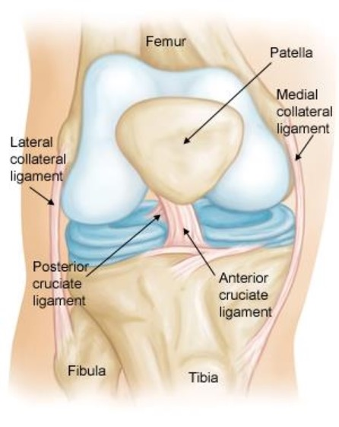
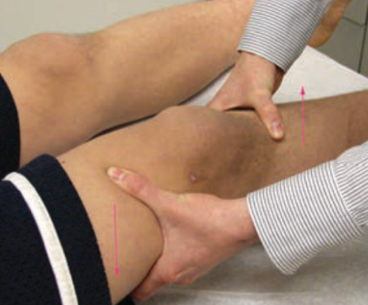
ACL Tear
Sports: soccer, basketball, football, skiing
Mechanism: hyperextension or valgus / rotational force to the knee with the foot planted, contact or non-contact (landing, rapid deceleration, sudden change of direction)
Presentation: ≥ 11 years old, painful “pop” felt or heard, followed by immediate swelling, feeling of instability, difficulty bearing weight
Exam: large effusion, limited ROM, exam may be limited by effusion, positive Lachman and/or anterior drawer test

Slide 7
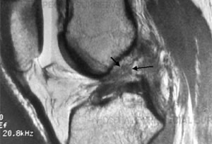
ACL Tear
Diagnosis: clinical, rule out other ligament/meniscus injuries with exam and XR, MRI to confirm (see above)
Plan: immediate immobilization and RICE, early PT (within 5-7 days), referral to ortho for operative treatment, transition to hinged knee brace and weight bearing as tolerated, PT for rehabilitation
When to refer: immediately after acute injury
Prognosis: many return to previous level of competition, usually 9+ months after operative treatment, ~10% risk of graft rupture
Prevention: neuromuscular training programs (strengthening, balance, agility, safe landing mechanics), cross-training

Slide 8
Case 2
15 year-old male presents one week after a left knee injury that occurred while skiing.
He fell while skiing on an icy slope downhill and felt a painful “pop” as his left leg twisted under him. He had a little swelling the first few days which has improved with rest and ice. He intermittently feels a catching sensation when he flexes and extends his knee. His pain is located on the lateral aspect of the knee.
On exam, he has a trace knee effusion and lateral joint line tenderness. His pain is reproduced with a deep squat.

Slide 9
Case 2
What is the most likely diagnosis?
Meniscus tear
Osteochondritis dissecans
ACL tear
Tibial eminence fracture
Patellar dislocation

Slide 10
Case 2
What is the most likely diagnosis?
Meniscus tear
Osteochondritis dissecans
ACL tear
Tibial eminence fracture
Patellar dislocation

Slide 11
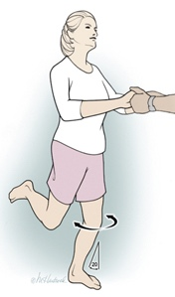
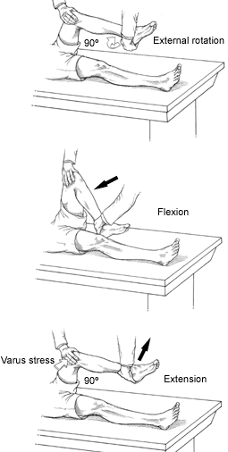
Meniscus Injury
Sports: any involving twisting or pivoting
Mechanism: twisting or pivoting while running or jumping
Presentation: ≥ 14 years old, painful “pop” during twisting injury, delayed swelling and may be minimal, mechanical symptoms (snapping, catching, locking sensation, limited ROM)
Exam: small effusion, joint line tenderness, limited ROM, positive Thessaly (top), positive McMurray (bottom), pain with deep squat or duck-walk (walking in deep squat position)

Slide 12
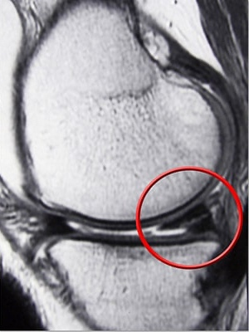
Meniscus Injury
Diagnosis: MRI, rule out other injuries with exam and XR
Plan: depends on location and size/type of tear, PT, many will require operative treatment
When to refer: all meniscus tears, urgently if inability to extend knee (suggests displaced tear locked between tibia / femur)
Prognosis: many return to previous level of competition, long-term may develop early osteoarthritis

Slide 13
Case 3
14 year-old male presents one day after a left knee injury that occurred while playing basketball.
He felt a painful “pop” as he jumped up to catch a rebound in the fourth quarter of the game. He was unable to walk off the court unsupported. His knee became immediately swollen within 20 minutes of the injury.
On exam, he has soft tissue swelling and TTP over the tibial tubercle. He is unable to fully extend at the knee or perform a straight leg raise when laying supine.

Slide 14
Case 3
What is the most likely diagnosis?
Tibial eminence fracture
Osteochondritis dissecans
ACL tear
Tibial avulsion fracture
Patellar dislocation

Slide 15
Case 3
What is the most likely diagnosis?
Tibial eminence fracture
Osteochondritis dissecans
ACL tear
Tibial avulsion fracture
Patellar dislocation

Slide 16
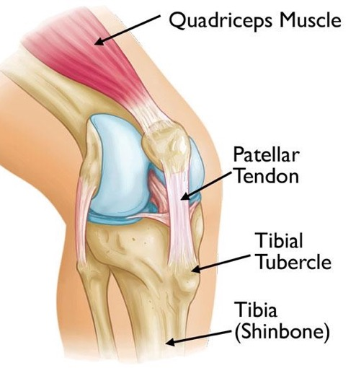
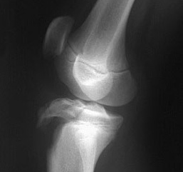
Tibial Avulsion Fracture
Sports: jumping or kicking sports (soccer, basketball, volleyball)
Mechanism: sudden forceful contraction of quadriceps, often during repetitive, forceful jumping or kicking
Presentation: adolescence, painful “pop” during jumping, kicking, or landing, immediate swelling, difficulty bearing weight
Exam: inability to extend knee or perform straight leg raise, swelling and TTP over tibial tubercle
Diagnosis: XR (AP and lateral), distinguish from Osgood-Schlatter (which has mild fragmentation of apophysis but no fracture)

Slide 17
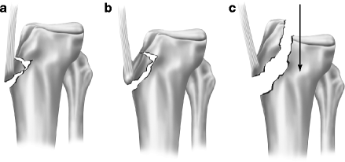
Tibial Avulsion Fracture
Plan: types I/II (a/b in figure) long-leg cast immobilization with knee in extension for 4-6 weeks followed by PT
When to refer: urgently, for surgical fixation, if significant displacement or type III (c in figure)
Prognosis: complete healing and return to previous level of activity with proper treatment, no growth disturbance
Prevention: maintain flexibility, especially during growth spurts
Watson-Jones classification Of note, type III passes across the epiphyseal plate and proximal articular surface of tibia (Salter-Harris Type III)

Slide 18
Case 4
16 year-old female presents one day after a right knee injury that occurred while playing softball.
She felt a painful “pop” as she twisted suddenly to swing her bat, and felt her kneecap shift out of place. She felt it pop back into place as she stood up quickly. Her knee was immediately swollen and she had difficulty bearing weight as she walked off.
On exam, she has TTP along the medial aspect of the knee and medial patellar edge. She has a small effusion, so your examination is limited by swelling and pain.

Slide 19
Case 4
What is the most likely diagnosis?
Patellofemoral pain syndrome
Osteochondritis dissecans
ACL tear
Tibial avulsion fracture
Patellar dislocation

Slide 20
Case 4
What is the most likely diagnosis?
Patellofemoral pain syndrome
Osteochondritis dissecans
ACL tear
Tibial avulsion fracture
Patellar dislocation

Slide 21
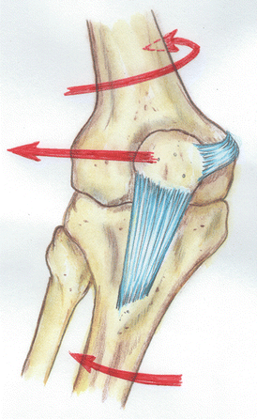
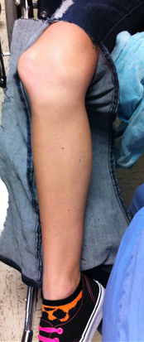
Patellar Dislocation
Sports: any involving sudden twisting or lateral changes of direction
Mechanism: sudden internal twisting force applied to semi-flexed knee on planted foot (e.g. spinning or twirling maneuver in dance or gymnastics, swinging baseball bat, quick lateral change of direction while running or ice skating), less commonly direct trauma to medial knee
Presentation: 10-17 years old, painful “pop” or tearing sensation, feeling patella shift out of place, majority dislocate laterally, most reduce spontaneously with knee extension, immediate swelling, limited ROM, difficulty bearing weight

Slide 22
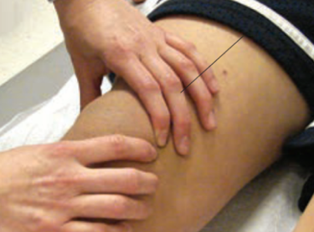
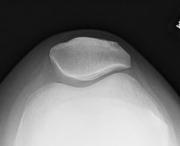
Patellar Dislocation
Exam: patellar TTP especially along medial edge, effusion in acute dislocation, positive patellar apprehension test (left)
Diagnosis: clinical, pre/post reduction XR to rule out osteochondral fracture, sunrise vs. merchant view may show lateral patellar tilt after reduction (right)
Plan: prompt reduction if not spontaneous, immobilization in extension & non-weight bearing for 7-10 days, transition to patellar stabilizing brace and weight bearing as tolerated, PT for rehabilitation, RTP in 8-12 weeks
When to refer: recurrent dislocations despite PT, osteochondral fracture or loose body
Prognosis: risk of recurrence, 30-50% with chronic patellofemoral pain
Prevention: patellar stabilizing brace during activity to prevent recurrent instability, lower extremity strengthening (quadriceps, hips)

Slide 23
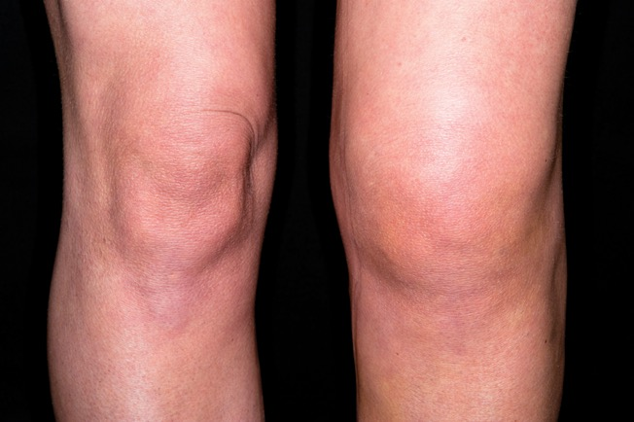
Knee Red Flag Symptoms
Painful “pop” at injury
Effusion
Dislocation or shifting of patella
Instability
Mechanical symptoms: catching, locking, or inability to extend knee

Slide 24
Inversion Ankle Injuries

Slide 25
Case 5
16 year-old male presents two days after an ankle injury that occurred while playing basketball.
He landed on an inverted ankle after jumping for a rebound and had immediate lateral ankle pain. He has had difficulty bearing weight since then along with some mild swelling and bruising along the lateral ankle.
On exam, ROM is limited by pain. He has mild swelling over the lateral ankle, with TTP anterior and inferior to the lateral malleolus. Anterior drawer test is positive.

Slide 26
Case 5
What is the most likely diagnosis?
5th metatarsal avulsion fracture
Peroneal tendon subluxation
High ankle sprain
Distal fibula fracture
Lateral ankle sprain

Slide 27
Case 5
What is the most likely diagnosis?
5th metatarsal avulsion fracture
Peroneal tendon subluxation
High ankle sprain
Distal fibula fracture
Lateral ankle sprain

Slide 28
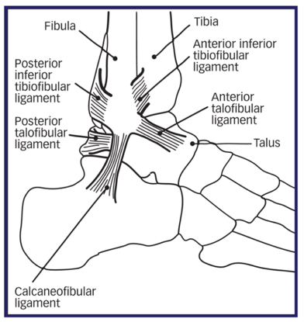
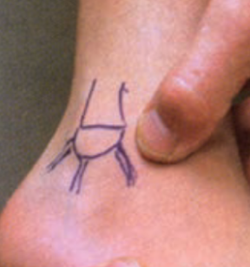
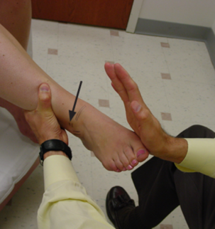
Lateral Ankle Sprain
Sports: basketball, soccer, football, volleyball
Mechanism: excessive inversion of plantarflexed ankle, twisting injury
Most common ligaments: anterior talofibular ligament (ATFL), then calcaneofibular (CFL)
Presentation: adolescence, acute lateral ankle pain, +/- “pop” at time of injury, pain with weight bearing, +/- swelling and/or bruising
Exam: ROM limited by pain, TTP over injured ligament, +/- positive anterior drawer (ATFL) and talar tilt (CFL) tests (see next slide) – may have false negative in acute phase due to guarding
Must rule out syndesmosis sprain (high ankle sprain): mechanism: excessive external rotation on dorsiflexed ankle, exam with positive squeeze test (right) and pain with forced external rotation (left)

Slide 29
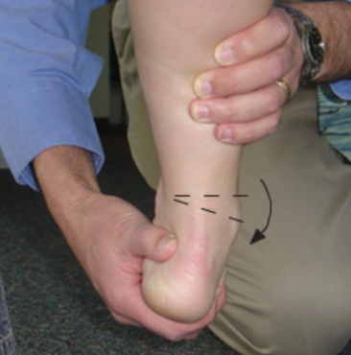
Lateral Ankle Sprain
Diagnosis: clinical, XR to rule out fracture if meets Ottawa ankle rules criteria (see imaging slide)
XR required if medial or syndesmosis sprain
Plan: RICE, NSAIDs for 7-10 days after injury, weight bearing as tolerated, may need crutches/boot, early PT for rehabilitation (ROM, flexibility, strength, proprioception)
When to refer: persistent symptoms despite comprehensive rehabilitation, syndesmosis sprain
Prognosis: RTP in 1-4 weeks depending on grade, re-injury risk 5x higher after initial injury, risk of chronic instability or pain with improper rehabilitation
Prevention: rehabilitation that includes proprioception training, ankle brace or taping
Top: Talar tilt test (CFL)
Bottom: Anterior drawer test (ATFL)

Slide 30
Case 6
11 year-old male presents three days after an ankle injury that occurred while playing soccer.
He twisted his ankle inwards during practice and is now complaining of lateral ankle pain. He has had difficulty bearing weight since then along with some mild swelling.
On exam, he has mild soft tissue swelling over the lateral ankle, with TTP over the distal fibula.

Slide 31
Case 6
What is the most likely diagnosis?
5th metatarsal avulsion fracture
Peroneal tendon subluxation
High ankle sprain
Distal fibula fracture
Lateral ankle sprain

Slide 32
Case 6
What is the most likely diagnosis?
5th metatarsal avulsion fracture
Peroneal tendon subluxation
High ankle sprain
Distal fibula fracture
Lateral ankle sprain

Slide 33
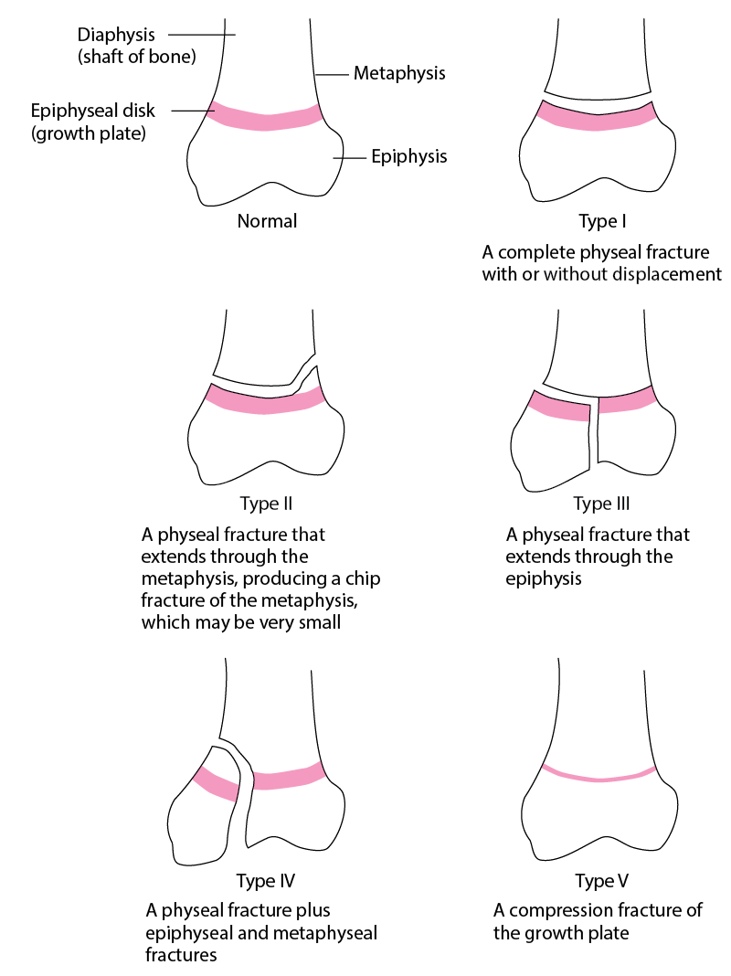
Salter-Harris I Distal Fibula Fracture
Sports: basketball, soccer, football, volleyball
Mechanism: acute inversion injury
In a child, physis is weaker than ligaments, so skeletally immature children more likely to have physeal fracture than ligament sprain
SH 1: traverses across physis without entering epiphysis or metaphysis
Presentation: skeletally immature (<12-15 years old), acute lateral ankle pain, pain with weight bearing, +/- mild swelling
Exam: TTP over distal fibular physis (~1 cm above tip of fibula), +/- soft tissue swelling over distal fibula

Slide 34
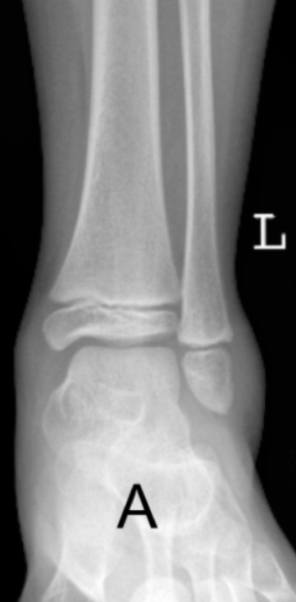
Salter-Harris I Distal Fibula Fracture
Diagnosis: clinical, XR (AP, lateral, mortise) frequently normal, may show soft tissue swelling or subtle physeal widening
Regardless of XR, any skeletally immature child with TTP over distal fibula after inversion injury is treated for SH I fracture of distal fibula
Plan: pain-free weight bearing with immobilization in walker boot (+/- crutches) for 3-4 weeks, re-evaluate in 2-3 weeks, RTP when no TTP and pain-free weight bearing
When to refer: displaced fractures, may need reduction +/- surgical fixation
Prognosis: complete healing and full RTP expected, growth disturbance <1%

Slide 35
Case 7
14 year-old female presents two days after an ankle injury that occurred while playing volleyball.
She felt a painful “pop” on the lateral side of her foot as she landed from a spike on an inverted ankle. She had immediate pain and had difficulty bearing weight as she walked off.
On exam, she has swelling and bruising along the lateral aspect of the foot, with focal TTP over the tuberosity.

Slide 36
Case 7
What is the most likely diagnosis?
5th metatarsal avulsion fracture
Peroneal tendon subluxation
High ankle sprain
Distal fibula fracture
Lateral ankle sprain

Slide 37
Case 7
What is the most likely diagnosis?
5th metatarsal avulsion fracture
Peroneal tendon subluxation
High ankle sprain
Distal fibula fracture
Lateral ankle sprain

Slide 38
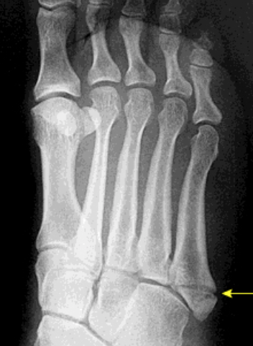
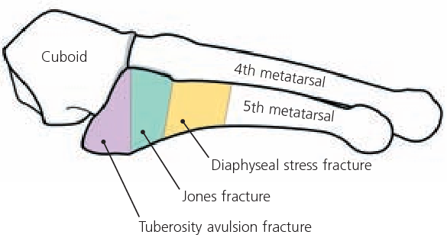
5th Metatarsal Tuberosity Avulsion Fracture
Sports: basketball, soccer, football, volleyball
Mechanism: excessive inversion of plantarflexed ankle, twisting injury
Presentation: sudden, painful “pop” or snap at the lateral foot at time of injury, pain with weight bearing, +/- swelling and/or bruising
Exam: TTP, swelling, and bruising along lateral aspect of foot at base of 5th metatarsal over tuberosity (styloid)

Slide 39
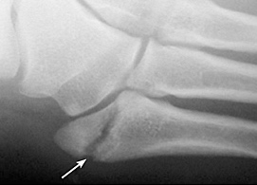
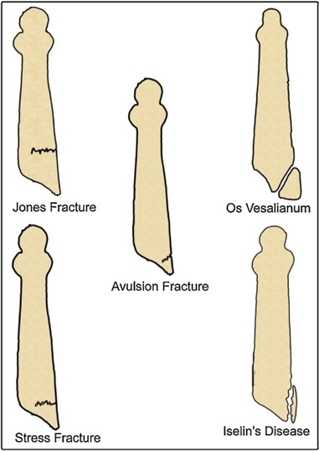
5th Metatarsal Tuberosity Avulsion Fractures
Diagnosis: XR required (AP, lateral, oblique): transverse fracture line through tuberosity perpendicular to long axis of the metatarsal
Differentiate from normal apophysis: fleck of bone parallel to long axis of 5th metatarsal, seen in girls 9-11 and boys 11-14 years old
Differentiate from Jones fracture: stress fracture of proximal 5th metatarsal at diaphyseal-metaphyseal junction, risk of nonunion, may need surgical fixation
Plan: weight bearing as tolerated in cast or walking boot, RTP when no TTP and pain-free weight bearing, usually at 3-4 weeks
When to refer: displaced fractures, may need surgical fixation
Prognosis: complete healing, full RTP expected

Slide 40
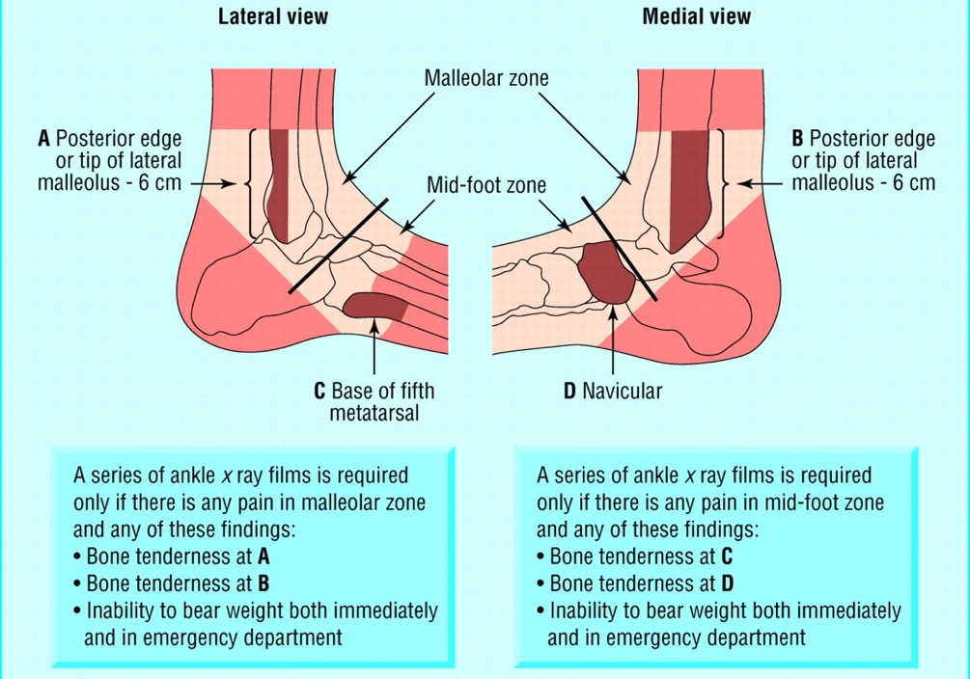
Ankle Injury: Indications for Imaging
Ottawa Ankle Rules

Slide 41
References & Image Sources

Slide 42
References
American Academy of Pediatrics, Preparticipation Physical Evaluation Monograph, 5th Edition, 2019.
Brenner JS, AAP Council on Sports Medicine and Fitness. Sports Specialization and Intensive Training in Young Athletes. Pediatrics. 2016;138(3):e20162148.
Carek PJ, et al. The preparticipation physical examination history: who has the correct answers? Clin J Sport Med. 1999;9(3):124-8.
Chun J, et al. The relative contributions of the history and physical examination in the preparticipation evaluation of collegiate student-athletes. Clin J Sport Med. 2006;16(5):437-8.
Coleman N. Sports Injuries. Pediatrics in Review. 2019;40(6):278-90.
Donnell-Fink LA, et al. Effectiveness of knee injury and anterior cruciate ligament tear prevention programs: a meta-analysis. PLoS One. 2015;10(12):e0144063.
Drezner JA, et al. AMSSM Position Statement on Cardiovascular Preparticipation Screening in Athletes: Current Evidence, Knowledge Gaps, Recommendations, and Future Directions. Clin J Sport Med. 2016;26(5):347-61.
Drezner JA, et al. International criteria for electrocardiographic interpretation in athletes: Consensus statement. Br J Sports Med. 2017;51(9):704-31.
Dubon ME, et al. Care of the Transgender Athlete. Curr Sports Med Rep. 2018;17(12):410-8.
Ellington MD, et al. Pediatric Elbow and Wrist Pathology Related to Sports Participation. Orthop Clin North Am. 2016;47(4):743-8.
Emery CA, et al. Neuromuscular training injury prevention strategies in youth sport: a systematic review and meta-analysis. Br J Sports Med. 2015;49:865-70.
Gomez JE, et al. Critical evaluation of the 2-minute orthopedic screening examination. Am J Dis Child. 1993;147(10):1109-13.
Haider, et al. Exercise for Sport-Related Concussion and Persistent Postconcussive Symptoms. Sports Health. 2021;13(2):154-60.
Halstead ME, et al. Sport-Related Concussion in Children and Adolescents. Pediatrics. 2018;142(6):e20183074.
Hewett TE, et al. Biomechanical measures of neuromuscular control and valgus loading of the knee predict anterior cruciate ligament injury risk in female athletes: a prospective study. Am J Sports Med. 2005;33(4):492-501.
Hewett TE, et al. Preparticipation physical examination using a box drop vertical jump test in young athletes: the effects of puberty and sex. Clin J Sport Med. 2006;16(4):298-304.

Slide 43
References
Koester MC, et al. Preparticipation screening of high school athletes: are recommendations enough? Phys Sportsmed. 2003;31(8):35-8.
LaBella et al, Anterior Cruciate Ligament Injuries: Diagnosis, Treatment, and Prevention. Pediatrics. 2014;133(5)e1437-50.
Lauersen JB, et al. Strength training as superior, dose-dependent and safe prevention of acute and overuse sports injuries: a systematic review, qualitative analysis and meta-analysis. Br J Sports Med. 2018;52:1557-63.
MacDonald J, et al. Musculoskeletal Low Back Pain in School-aged Children: A Review. JAMA Pediatr. 2017;171(3):280-7.
Maron BJ, et al. Assessment of the 12-lead electrocardiogram as a screening test for detection of cardiovascular disease in healthy general populations of young people (12-25 years of age): a scientific statement from the American Heart Association and the American College of Cardiology. J Am Coll Cardiol. 2014;64(14):1479-1514.
Maron BJ, et al. Eligibility and Disqualification Recommendations for Competitive Athletes With Cardiovascular Abnormalities: Preamble, Principles, and General Considerations: A Scientific Statement From the American Heart Association and American College of Cardiology. Circulation. 2015;132(22):e256-61.
Marra J, et al. Clinical Considerations in Caring for Transgender Athletes. Am Fam Physician. 2021;103(9):518-20.
Miller SM, et al. The Sports Preparticipation Evaluation. Pediatrics in Review. 2019;40(3):108-28.
Mountjoy M, et al. The IOC consensus statement: beyond the Female Athlete Triad – relative energy deficiency in sport (RED-S). Br J Sports Med. 2014;48:491-7.
Mountjoy M, et al. IOC consensus statement on relative energy deficiency in sport (RED-S): 2018 update. Br J Sports Med. 2018;52(11):687-97.
Nigrovic LE, et al. Children With Minor Blunt Head Trauma Presenting to the Emergency Department. Pediatrics. 2019;144(6):e20191495.
Sarwark, JS, & LaBella, CR (2014). Pediatric Orthopaedics and Sports Injuries: A Quick Reference Guide, 2nd Edition. American Academy of Pediatrics.
Smith J, et al. The preparticipation physical examination: Mayo Clinic experience with 2,739 examinations. Mayo Clin Proc. 1998;73(5):419-29.
Thorborg K, et al. Effect of specific exercise-based football injury prevention programmes on the overall injury rate in football: a systematic review and meta-analysis of the FIFA 11 and 11+ programmes. Br J Sports Med. 2017;51:562-71.
Rice SG, AAP Council on Sports Medicine and Fitness. Medical conditions affecting sports participation. Pediatrics. 2008;121(4):841-8.

Slide 44
Image Sources
In order of appearance
Knee anatomy diagram: American Academy of Orthopaedic Surgeons, OrthoInfo, Anterior Cruciate Ligament (ACL) Injuries: https://orthoinfo.aaos.org/en/diseases--conditions/anterior-cruciate-ligament-acl-injuries/
Lachman test: Sarwark, JS, & LaBella, CR (2014). Pediatric Orthopaedics and Sports Injuries: A Quick Reference Guide, 2nd Edition. American Academy of Pediatrics.
Torn ACL MRI: Hospital for Special Surgery, Torn ACL: https://www.hss.edu/condition-list_torn-acl.asp
Thessaly test: Grover M. Evaluating acutely injured patients for internal derangement of the knee. Am Fam Physician. 2012;85(3):247-52.
McMurray test: Calmbach WL, et al. Evaluation of patients presenting with knee pain: Part I. History, physical examination, radiographs, and laboratory tests. Am Fam Physician. 2003;68(5):907-12.
Torn meniscus MRI: American Academy of Orthopaedic Surgeons, OrthoInfo, Meniscus Tears: https://orthoinfo.aaos.org/en/diseases--conditions/meniscus-tears/
Knee anatomy diagram: American Academy of Orthopaedic Surgeons, OrthoInfo, Osgood-Schlatter Disease (Knee Pain): https://orthoinfo.aaos.org/en/diseases--conditions/osgood-schlatter-disease-knee-pain/
Tibial avulsion fracture radiograph: OrthoBullets, Tibial Tubercle Fracture: https://www.orthobullets.com/pediatrics/4023/tibial-tubercle-fracture
Tibial tuberosity fracture classification: Mostofi SB (2012) Fractures in Children. In: Fracture Classifications in Clinical Practice 2nd Edition. Springer, London.
Patellar dislocation diagram: Coviello M, Mazzola C (2016) Management of the First Patellar Dislocation. In: Volpi P. (eds) Arthroscopy and Sport Injuries. Springer, Cham.
Patellar dislocation image: OrthoBullets, Patellar Instability: https://www.orthobullets.com/knee-and-sports/3020/patellar-instability
Patellar apprehension test: Sarwark, JS, & LaBella, CR (2014). Pediatric Orthopaedics and Sports Injuries: A Quick Reference Guide, 2nd Edition. American Academy of Pediatrics.

Slide 45
Image Sources
In order of appearance
Patella sunrise view radiograph: Clinical Pain Advisor, Knee Pain Over the Lateral Patellofemoral Facet Joint: https://www.clinicalpainadvisor.com/slideshow/case-studies/knee-pain-over-the-lateral-patellofemoral-facet-joint/
Knee effusion image: GP Online, Management of ACL rupture: https://www.gponline.com/management-acl-rupture/musculoskeletal-disorders/musculoskeletal-disorders/article/1287144
Lateral ankle anatomy diagram and landmarks: Sarwark, JS, & LaBella, CR (2014). Pediatric Orthopaedics and Sports Injuries: A Quick Reference Guide, 2nd Edition. American Academy of Pediatrics.
Ankle sprain testing (squeeze test, external rotation stress test, talar tilt, anterior drawer tests): 2021 UpToDate, Maughan KL. Ankle sprain.
Salter-Harris fracture classification: Merck Manual, Professional Version, Campagne D, Pediatric Physeal (Growth Plate) Fractures: https://www.merckmanuals.com/en-pr/professional/injuries-poisoning/fractures/pediatric-physeal-growth-plate-fractures
Distal fibular fracture radiograph: CanadiEM, Choosing Wisely: Low Risk Pediatric Ankle Fractures: https://canadiem.org/choosing-wisely-low-risk-pediatric-ankle-fractures/
5th metatarsal avulsion fracture radiograph: 2021 UpToDate, Alsobrook J & Hatch RL. Proximal fifth metatarsal fractures.
5th metatarsal fracture zones diagram: Hatch RL, et al. Diagnosis and management of metatarsal fractures. Am Fam Physician. 2007;76(6):817-26.
5th metatarsal avulsion fracture radiograph: Hatch RL, et al. Diagnosis and management of metatarsal fractures. Am Fam Physician. 2007;76(6):817-26.
Iselin and 5th metatarsal fracture types diagram: Kishan TV, et al. Iselin's disease: Traction apophysitis of the fifth metatarsal base, a rare cause of lateral foot pain. Medical Journal, Armed Forces India. 2016;72(3):299-301.
Ottawa ankle rules figure: Bachmann L M, et al. Accuracy of Ottawa ankle rules to exclude fractures of the ankle and mid-foot: systematic review. BMJ. 2003;326:417.

