Slide 1
Pediatric Primary Care Sports Medicine Handbook Overuse and Chronic Injuries A Case-Based Approach
Faustine D. Ramirez, MD
Pediatric Residency Program, University of California San Francisco
Celina de Borja, MD
Pediatric Primary Care Sports Medicine
Assistant Clinical Professor, University of California San Francisco

Slide 2
Outline
Apophysis and epiphysis injuries
Muscle and tendon injuries
Bone stress injuries
Back pain
Early sport specialization
Relative energy deficiency in sport

Slide 3
Overuse Injuries in Youth Athletes
Occur when anatomic structures are subjected to repetitive stress, resulting in forces beyond what the structure can withstand
Affect bones, growth centers (physes, apophyses), tendons, fascia
Common features:
Chronic
Insidious onset
Intermittent
Worse with activities
Improved with rest

Slide 4
Risk Factors for Overuse Injuries
Intrinsic factors
Imbalances or deficits in strength and flexibility
Related to growth/development
Increased bone plasticity
Open, weak physes
Ligamentous laxity
Underdeveloped muscles
Poor technique or mechanics
Normal variants of anatomic alignment (less common)
Femoral version or lower extremity valgus
Pes planus or pes cavus

Slide 5
Risk Factors for Overuse Injuries
Extrinsic factors
Rapid increase in training (FIT, Frequency, Intensity, Time)
Long-term, high training volume
Goal: hours/week < age in years
Suboptimal equipment
Poor training surfaces or sudden change in training surface
Early sport specialization
Long-term high-level training in a single sport
Year-round participation (> 8 months/year), multiple teams
No consensus about specific age for "early" sports specialization: <12 years (AOSSM) vs. before adolescence (AAP/AMSSM)

Slide 6
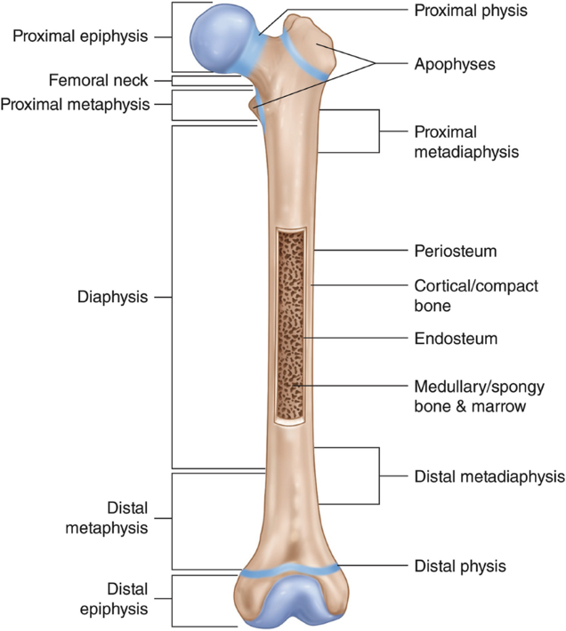
Apophyseal Injuries
Bone and tendon: composed of strong extracellular matrix designed to withstand compressive and tensile loads
Growth plates: composed mainly of cartilage cells, so they have little resistance to stress
Apophyses: areas of secondary ossification, where muscle-tendon units attach to bone
Weakest point in biomechanical chain

Slide 7
Apophyseal Injuries
Imbalance or deficits in strength and flexibility
Bones grow faster than muscles
As bones get longer, muscles get tighter
Apophyses: weakest point in biomechanical chain
Exacerbated by increased physical demands
Once skeletally mature, some injuries will transition from apophysitis to tendonitis if underlying imbalances/deficits are not corrected

Slide 8
Case 1
10 year-old right-hand dominant male p/w atraumatic right elbow pain x 6 weeks.
He is a pitcher for his baseball team, plays 4-5 times a week.
Pain is intermittent, worse with pitching/throwing, improved with rest, progressing over the past 4-6 weeks.
He reports loss of pitching velocity and accuracy.
On exam, TTP over medial epicondyle with mild swelling, limited ROM, and pain with valgus stress testing.

Slide 9
Case 1
What is the most likely diagnosis?
Flexor-pronator tendinitis
Ulnar collateral ligament sprain
Osteochondritis dissecans of capitellum
Medial epicondyle apophysitis
Ulnar neuritis

Slide 10
Case 1
What is the most likely diagnosis?
Flexor-pronator tendinitis
Ulnar collateral ligament sprain
Osteochondritis dissecans of capitellum
Medial epicondyle apophysitis
Ulnar neuritis

Slide 11
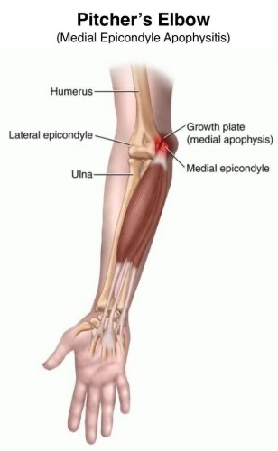
Medial Epicondyle Apophysitis
Little League Elbow
Sports: overhead athletes and throwers
Mechanism: repetitive valgus force at elbow that occurs with pitching/throwing motion → traction stress at medial side of elbow
Presentation: 9-12 years old, medial elbow pain during or after pitching, +/- stiffness or swelling, limited elbow extension, occasionally mechanical symptoms
Exam: focal TTP over medial epicondyle, +/- swelling or effusion

Slide 12
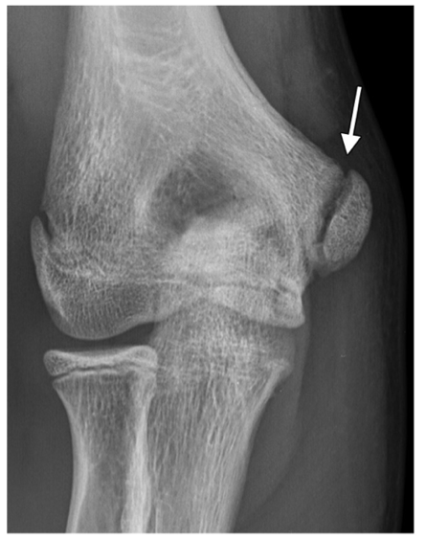
Medial Epicondyle Apophysitis
Little League Elbow
Diagnosis: clinical, XR often negative in early stages but may show physeal widening, sclerosis, fragmentation
Plan: rest until pain and tenderness resolve (usually 4-6 weeks), PT when pain-free, then RTP over 4-6 weeks gradually
When to refer: no improvement after 6-8 weeks of rest, guidance for PT or clearance for return to throwing, widening or displacement of apophysis > 5 mm
Prognosis: return to competitive sports 8-12 weeks, if untreated risk of avulsion fracture, growth disturbance, arthrosis
Prevention: pitch count guidelines, education, biomechanics, core strength and cardiovascular fitness

Slide 13
Case 2
12 year-old male p/w atraumatic right knee pain x 2 weeks.
He plays basketball on his middle school team and recently joined a traveling club team.
Pain is anterior, intermittent, worse with running and jumping, improved with rest.
On exam, he has tight hamstrings and quadriceps, and TTP over the inferior pole of the patella.

Slide 14
Case 2
What is the most likely diagnosis?
Osgood-Schlatter disease
Patellofemoral pain syndrome
Sinding-Larsen-Johansson
Patellar tendonitis
Osteochondritis dissecans

Slide 15
Case 2
What is the most likely diagnosis?
Osgood-Schlatter disease
Patellofemoral pain syndrome
Sinding-Larsen-Johansson
Patellar tendonitis
Osteochondritis dissecans

Slide 16
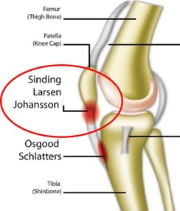
Knee Extensor Mechanism Apophysitis
Osgood-Schlatter and Sinding-Larsen-Johansson
Sports: running or jumping sports (basketball, soccer, gymnastics)
Mechanism: rapid growth, tight quadriceps, increased physical demands → traction stress along the knee extensor mechanism, leads to apophysitis of:
Tibial tuberosity: Osgood-Schlatter (OS)
Inferior pole of patella: SLJ
Presentation: 9-15 years old, anterior knee pain during running/jumping activities, localized TTP (tibial tuberosity for OS vs. inferior pole of patella for SLJ), +/- painful resisted knee extension (OS), tight quadriceps and/or hamstrings

Slide 17
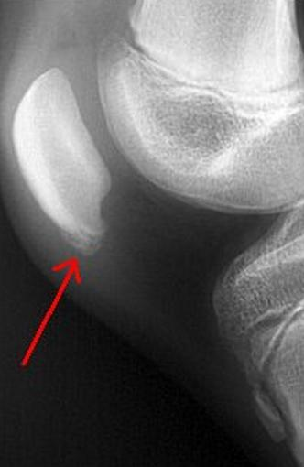
Knee Extensor Mechanism Apophysitis
Osgood-Schlatter and Sinding-Larsen-Johansson
Diagnosis: clinical, XR may help rule out other pathology if atypical presentation
Irregular or fragmented tibial tubercle can be normal variant and does not indicate OS (blue)
For SLJ may see irregular or fragmented inferior pole of patella (red)
Plan: activity modifications, patellar strap, PT (quadriceps/hamstring stretching), ice/NSAIDs
When to refer: no improvement after several weeks of rest, c/f tibial tubercle avulsion fracture (OS)
Prognosis: waxes and wanes but will resolve over time, residual prominence of tubercle (OS), if untreated risk of avulsion fracture
Prevention: maintain flexibility, especially during growth spurts

Slide 18
Case 3
11 year-old female p/w atraumatic right foot pain x 4 weeks.
She plays club soccer 4 times a week and frequent tournaments on the weekends.
Pain is intermittent, over the posterior ankle and heel, worse with running/jumping and when wearing her cleats, and improved with rest.
On exam, she has diffuse TTP over posterior heel, pain elicited with calcaneal squeeze test, and tight calf muscles.

Slide 19
Case 3
What is the most likely diagnosis?
Calcaneal stress fracture
Plantar fasciitis
Sever disease
Achilles tendonitis
Retrocalcaneal bursitis

Slide 20
Case 3
What is the most likely diagnosis?
Calcaneal stress fracture
Plantar fasciitis
Sever disease
Achilles tendonitis
Retrocalcaneal bursitis

Slide 21
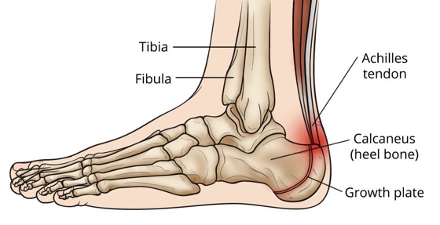
Calcaneal Apophysitis
Sever Disease
Sports: running or jumping sports (basketball, soccer, gymnastics)
Mechanism: repetitive traction stress from Achilles tendon or repetitive impact of heel
Presentation: 8-14 years old, activity-related heel pain, worse on hard surfaces or wearing cleats, +/- limping
Exam: tight calf muscles, TTP over Achilles tendon insertion, pain with calcaneal squeeze test (mediolateral compression of calcaneus), +/- pes planus (flatfoot) or over-pronation

Slide 22
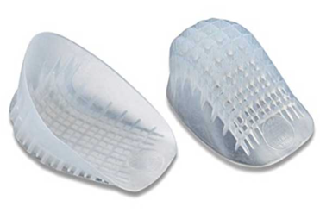
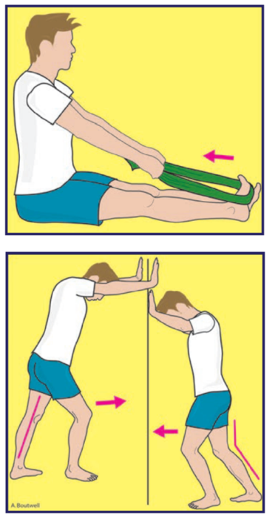
Calcaneal Apophysitis
Sever Disease
Diagnosis: clinical, XR may help rule out other pathology if atypical presentation
Plan: activity modifications, gel heel cups, PT (hamstring and calf stretching), ice/NSAIDs
Severe cases may need to be non-weight bearing with boot/cast
When to refer: no improvement in 6-8 weeks
Prognosis: waxes and wanes but will resolve over time, no long-term sequelae or complications
Prevention: maintain calf flexibility and ankle dorsiflexion during periods of rapid growth, limit use of cleats or time on hard surfaces

Slide 23
Case 4
12 year-old female p/w atraumatic right foot pain x 4 weeks.
Participates in ballet 3-4 times a week at ballet school.
Pain is on lateral aspect of foot, intermittent, worse with activity, improved with rest and walking on medial aspect of foot.
On exam, has pain with passive ankle inversion and resisted ankle eversion, and TTP on lateral aspect of midfoot.

Slide 24
Case 4
What is the most likely diagnosis?
Metatarsal fracture
Plantar fasciitis
Peroneal tendinitis
Iselin disease
Jones fracture

Slide 25
Case 4
What is the most likely diagnosis?
Metatarsal fracture
Plantar fasciitis
Peroneal tendinitis
Iselin disease
Jones fracture

Slide 26
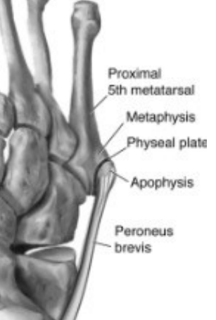
5th Metatarsal Apophysitis
Iselin Disease
Sports: sports that stress the forefoot (roller-skating, dance or ballet)
Mechanism: repetitive traction stress from peroneus brevis tendon
Presentation: 10-16 years old, lateral activity-related foot pain, may be exacerbated by shoe friction
Exam: TTP over base of 5th metatarsal, mild swelling, may favor medial side of foot when weight bearing, pain with passive ankle inversion and resisted ankle eversion

Slide 27
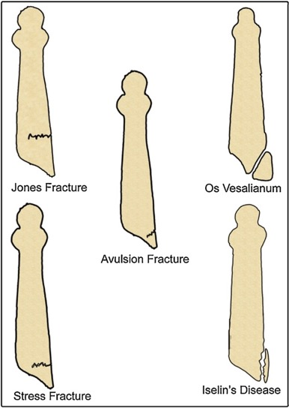
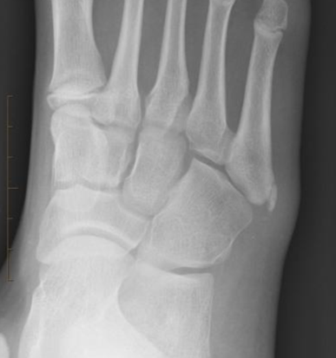
5th Metatarsal Apophysitis
Iselin Disease
Diagnosis: clinical, XR may help rule out other pathology if uncertain or rule out fracture in acute injury
Normal apophysis: fleck of bone parallel to long axis of 5th metatarsal (≠ avulsion fracture), visible in girls 9-11 and boys 11-14 years of age
Plan: activity modifications, PT (peroneal and calf stretching), ice/NSAIDs
When to refer: persistent pain or inability to return to activities despite treatment
Prognosis: waxes and wanes but will resolve over time, ossicles or bony prominence may persist but do not cause problems
Prevention: maintain calf, peroneal, and ankle flexibility and strength, check shoe size during rapid periods of growth

Slide 28
Case 5
13 year-old right-hand dominant male p/w atraumatic right shoulder pain x 4 weeks.
He is a pitcher for his baseball team, plays 4-5 times a week.
Pain is intermittent, worse with pitching/throwing, improved with rest, progressing over the past 2 weeks.
He reports loss of pitching velocity and accuracy.
On exam, TTP over proximal humerus, full ROM but mild discomfort with resisted ROM.

Slide 29
Case 5
What is the most likely diagnosis?
Rotator cuff tendinitis
Biceps tendinitis
Proximal humeral epiphysitis
Glenoid labrum tear
Glenohumeral instability

Slide 30
Case 5
What is the most likely diagnosis?
Rotator cuff tendinitis
Biceps tendinitis
Proximal humeral epiphysitis
Glenoid labrum tear
Glenohumeral instability

Slide 31
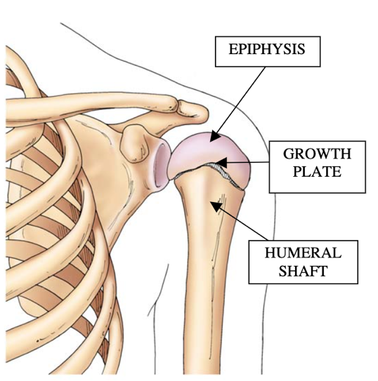
Proximal Humeral Epiphysitis / Epiphysiolysis
Little League Shoulder
Sports: throwing and overhead sports (swimming, tennis, volleyball)
Mechanism: repetitive microtraumatic traction or torque stress to proximal humeral physis
Presentation: 10-16 years old, progressive non-focal shoulder pain, worse with throwing/overhead activity, loss of throwing velocity or accuracy
Exam: TTP over proximal lateral humerus, +/- painful or decreased shoulder ROM, pain with resisted ROM

Slide 32
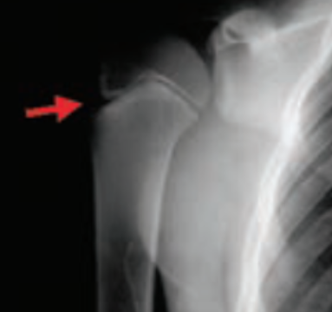
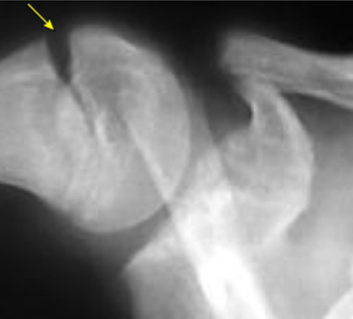
Proximal Humeral Epiphysitis / Epiphysiolysis
Little League Shoulder
Diagnosis: clinical, XR may show physeal widening (compare to unaffected side), +/- sclerosis, fragmentation
Plan: rest from overhead activities for ≥ 6 weeks, followed by gradual return to throwing over the next 6 weeks through PT guidance, full RTP usually in 3 months
When to refer: persistent pain despite 4-6 weeks of rest, pain at rest, instability, significant weakness
Prognosis: resolves with skeletal maturity, RTP usually within 3 months
Prevention: pitch count guidelines, education, biomechanics, core strength and cardiovascular fitness

Slide 33
Case 6
11 year-old female p/w atraumatic right wrist pain x 6 weeks.
She is a competitive gymnast and trains every day for 3-4 hours each day.
Pain is on the radial aspect of the wrist, worse with tumbling and vaulting, improved with rest.
On exam, she has mild distal forearm swelling, TTP over distal radius, and pain with hyperextension and axial loading.

Slide 34
Case 6
What is the most likely diagnosis?
Kienböck's disease
Wrist sprain
Distal radioulnar joint instability
Scaphoid stress fracture
Distal radial epiphysitis

Slide 35
Case 6
What is the most likely diagnosis?
Kienböck's disease
Wrist sprain
Distal radioulnar joint instability
Scaphoid stress fracture
Distal radial epiphysitis

Slide 36
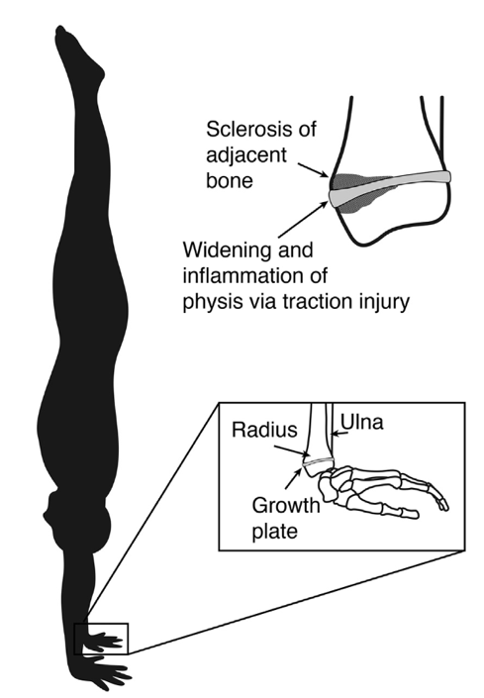
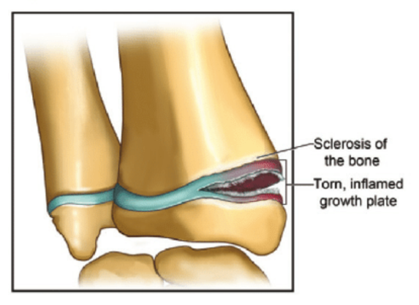
Distal Radial Epiphysitis
Gymnast Wrist
Sports: gymnastics most often, less commonly rock climbing, weight lifting
Mechanism: repetitive loading of extended wrist leading to compressive vs. traction stress injury of distal radial physis
Presentation: 10-14 years old, dorsal, radial wrist pain, worse with axial stress loading (vaulting, hand-walking)
Exam: mild distal forearm swelling, TTP over distal radius, pain with hyperextension and axial loading

Slide 37
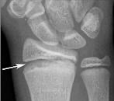
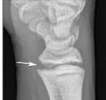
Distal Radial Epiphysitis
Gymnast Wrist
Diagnosis: clinical, XR shows widening and irregular borders of distal radius physis (compare to unaffected side)
Plan: non-weight bearing and cast (> splint) immobilization for 6-8 weeks, gradual RTP
When to refer: no improvement after 6-8 weeks
Prognosis: successful RTP if early intervention, can take up to 4-5 months if late to care, risk of recurrence and growth disturbance (radial shortening, ulnar overgrowth) which may require corrective surgery
Prevention: load management, strength and flexibility exercises, proper technique

Slide 38
Case 7
16 year-old female p/w atraumatic left knee pain x 2 months.
She plays lacrosse for her high school team 3-4 times a week.
Pain is anterior, intermittent, worse after running and prolonged sitting, improved with rest and stretching.
She also reports some knee instability, which feels like her knee is going to buckle or “give way”, especially when going down stairs.
On exam, she has non-specific TTP on both side of the patella, and pain with compression of the patella. Single leg squat on the left side is difficult to perform and reveals valgus collapse of her knee.

Slide 39
Case 7
What is the most likely diagnosis?
Patellar tendonitis
Patellofemoral pain syndrome
Iliotibial band syndrome
Osteochondritis dissecans
Patellar subluxation

Slide 40
Case 7
What is the most likely diagnosis?
Patellar tendonitis
Patellofemoral pain syndrome
Iliotibial band syndrome
Osteochondritis dissecans
Patellar subluxation

Slide 41
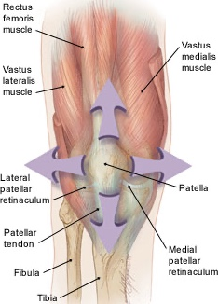
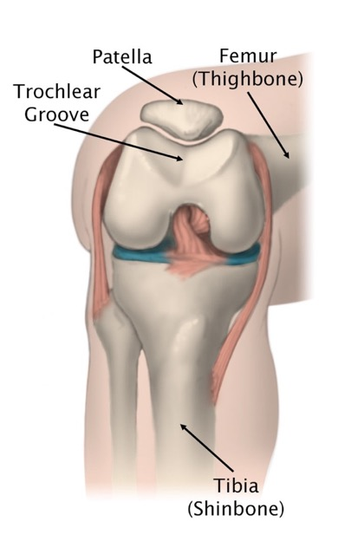
Patellofemoral Pain Syndrome
Sports: running or jumping sports (soccer, lacrosse, basketball), can also be seen in less active children
Mechanism: combination of overuse and abnormal patellar tracking → mechanical strain on retinaculum or subchondral bone
Quadriceps weakness and tightness, relative imbalance in strength and flexibility during periods of growth
Presentation: any age, non-specific anterior knee pain, usually bilateral, worse with activity (running, jumping, stairs) or after prolonged sitting, “giving way” sensation (caused by pain inhibiting quadriceps, resulting in knee collapse), +/- mild swelling or grinding, popping, cracking

Slide 42
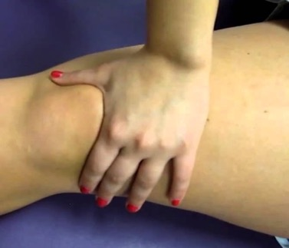
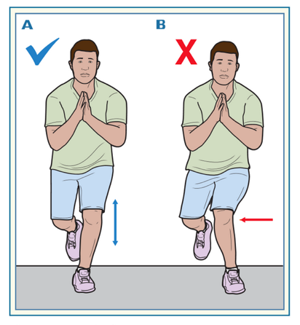
Patellofemoral Pain Syndrome
Exam: normal, may have infrapatellar swelling, TTP along patellar facets, positive patellar grind, weak hip abductors/external rotators (unstable single-leg squat with valgus collapse), tight quadriceps
Diagnosis: clinical, XR may help rule out other pathology if atypical presentation
Plan: activity modifications, PT (quadriceps, hamstrings, IT band, core and hip stabilizers), ice/NSAIDs, stabilizing brace or taping
When to refer: no improvement despite comprehensive rehabilitation program
Prognosis: spontaneous resolution over time
Prevention: avoid rapid increases in activities, maintain core and LE strength and flexibility (hip abductors/external rotators, quadriceps, hamstrings, IT band)

Slide 43
Case 8
17 year-old male p/w atraumatic right knee pain x 4 weeks.
He runs with his high school track and field team 3 times a week and cross-trains on his own 2 times a week with cycling and swimming.
Pain is on the lateral knee, burning, worse while running, improved with rest.
On exam, he has TTP on the lateral aspect of the knee, tight hip flexors and IT band R > L, and pain with compression of the lateral knee as it is flexed and extended back and forth. Single leg squat on the right side is difficult to perform and reveals valgus collapse of his knee.

Slide 44
Case 8
What is the most likely diagnosis?
LCL strain
Hamstring tendinitis
Patellofemoral pain syndrome
Iliotibial band syndrome
Lateral meniscal injury

Slide 45
Case 8
What is the most likely diagnosis?
LCL strain
Hamstring tendinitis
Patellofemoral pain syndrome
Iliotibial band syndrome
Lateral meniscal injury

Slide 46
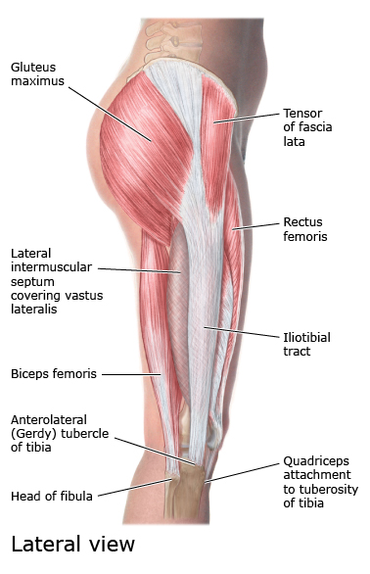
Iliotibial Band Syndrome
Sports: running and cycling most common, also soccer and other running sports
Mechanism: combination of overuse, malalignment (weak hip abductors), and muscle tightness (IT band, hip flexors, calf muscles)
Presentation: usually adolescence, lateral knee pain, worse with activity (running, cycling), improved with rest, sharp or burning

Slide 47
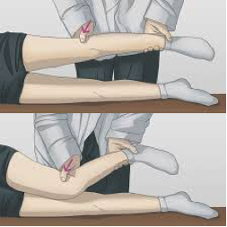
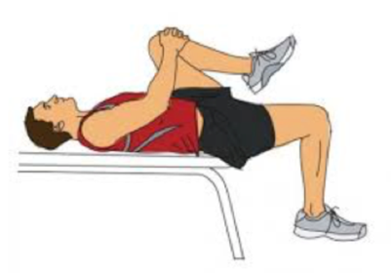
Iliotibial Band Syndrome
Exam: focal TTP at distal IT band as it courses over lateral knee, positive Noble compression test (top), tight IT band +/- hip flexors (Ober test (middle) or Thomas test (bottom))
Diagnosis: clinical
Plan: activity modifications, PT (address hip abductor weakness and IT band flexibility, core/hip stabilizers), ice/NSAIDs
When to refer: no improvement despite comprehensive rehabilitation program
Prognosis: spontaneous resolution over time
Prevention: avoid rapid increases in activities, maintain core and LE strength and flexibility (hip abductors/external rotators, IT band, hamstrings, calf muscles)

Slide 48
Case 9
15 year-old right-hand dominant male p/w atraumatic right shoulder pain x 4 weeks.
He swims for his high school and club team and trains 4-5 times a week with 2 meets on the weekends.
Pain is worse with swimming and overhead activities, improved with rest, and he has pain with overhead ADLs.
On exam, shoulder ROM and strength are limited by pain but there is no true weakness. He has TTP in the subacromial space. Resisted rotator cuff muscle testing elicits pain, and Hawkins test is positive.

Slide 49
Case 9
What is the most likely diagnosis?
Biceps tendonitis
Acromioclavicular sprain
Thoracic outlet syndrome
Rotator cuff impingement
Proximal humeral fracture

Slide 50
Case 9
What is the most likely diagnosis?
Biceps tendonitis
Acromioclavicular sprain
Thoracic outlet syndrome
Rotator cuff impingement
Proximal humeral fracture

Slide 51
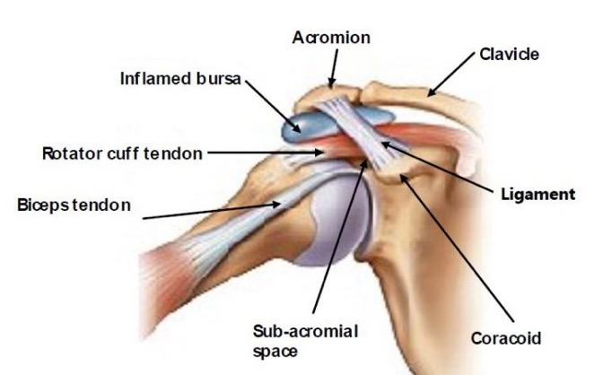
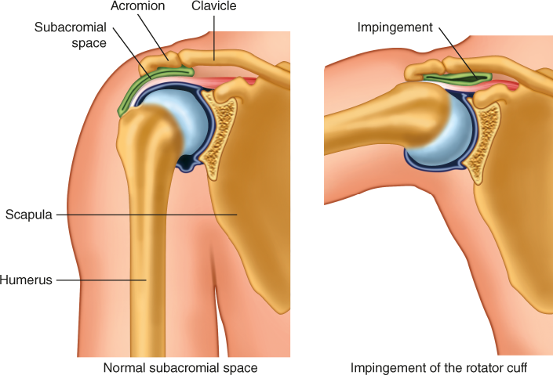
Rotator Cuff Impingement
Sports: overhead sports (tennis, baseball, softball, volleyball, swimming)
Mechanism: inflammation and thickening of rotator cuff (RTC) tendons or subacromial bursa, leads to impingement under coracoacromial arch with arm elevation (in pediatrics, due to muscle imbalances)
Presentation: adolescence, pain with overhead activity, may progress to pain with ADLs or at rest and night, +/- reduced strength with overhead activities

Slide 52
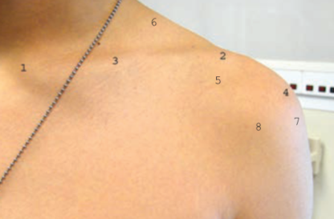
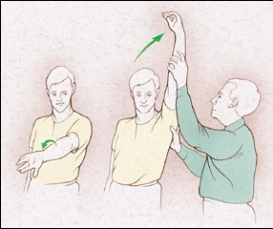
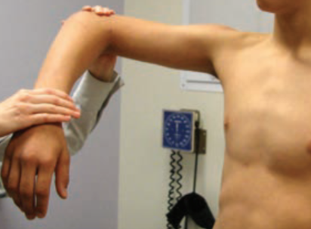
Rotator Cuff Impingement
Exam: TTP in subacromial space (top, #5), ROM +/- strength limited by pain, pain with resisted RTC testing, positive Neer (middle) and Hawkins (bottom) impingement tests
Diagnosis: clinical, XR if c/f Little League shoulder, MRI if there is concern for labral injury
Plan: rest from overhead activities, NSAIDs, PT (ROM, RTC strengthening, periscapular stabilization)
When to refer: no improvement with rest and PT
Prognosis: full RTP expected with PT (ranges from 2-4 weeks to 4-6 months), may progress/recur if muscle imbalances, joint stability, and/or biomechanics not addressed
Prevention: pitch count guidelines, education, biomechanics, core strength and cardiovascular fitness, RTC strengthening program

Slide 53
Case 10
12 year-old female p/w atraumatic right hip pain and snapping x 5 weeks.
She dances ballet and does gymnastics up to 6 times a week.
Pain is on anterior aspect of the right hip, worse with dancing, and she feels a snapping sensation whenever she flexes at the hip.
On exam, she has TTP over the hip flexor tendons, tight hip flexors, and full ROM at the hip. The pain and snapping are reproducible with active flexion but not passive ROM.

Slide 54
Case 10
What is the most likely diagnosis?
Labral tear
SCFE
Anterior inferior iliac spine apophysitis
Internal snapping hip
Hip adductor muscle strain

Slide 55
Case 10
What is the most likely diagnosis?
Labral tear
SCFE
Anterior inferior iliac spine apophysitis
Internal snapping hip
Hip adductor muscle strain

Slide 56
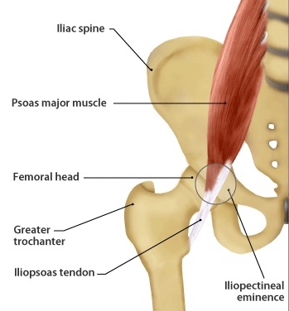
Internal Snapping Hip
Dancer’s Hip
Sports: sports with repetitive hip flexion (gymnastics, dancing)
Mechanism: tight or inflamed iliopsoas tendon subluxes over iliopectineal eminence or femoral head
Presentation: adolescence, anterior hip pain, snapping sensation with hip flexion or external rotation, sometimes audible, unilateral or bilateral
Exam: ROM often normal, flexion and external rotation may be limited by pain, +/- TTP over iliopsoas tendon, snapping reproducible with active hip flexion

Slide 57
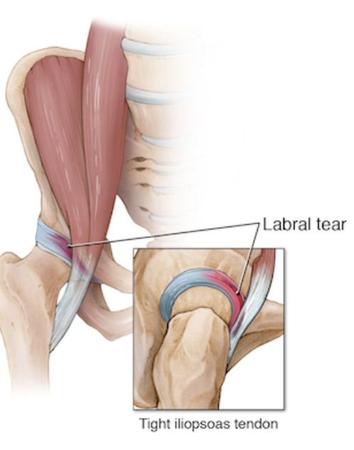
Internal Snapping Hip
Dancer’s Hip
Diagnosis: clinical, obtain XR to rule out other causes of anterior hip pain (should be normal), MRI arthrogram can distinguish from labral tear
Plan: PT (hip muscle strengthening and flexibility)
When to refer: persistent symptoms despite several months of PT
Prognosis: pain usually resolves with PT (may take 6+ months), snapping often persists, full RTP expected
May lead to labral tear
Prevention: maintain hip muscle strength and flexibility, avoid repetitive hip flexion activities

Slide 58
Case 11
13 year-old female p/w atraumatic right hip pain and snapping x 6 weeks.
She dances ballet and hip hop 5-6 times a week.
Pain is on lateral aspect of the right hip, worse with dancing, and she feels a snapping sensation whenever she flexes at the hip.
On exam, she has focal TTP over the lateral hip and a tight IT band. The pain and snapping are reproducible with active flexion and external rotation but not passive ROM.

Slide 59
Case 11
What is the most likely diagnosis?
Trochanteric bursitis
External snapping hip
Greater trochanter apophysitis
Femoral neck stress fracture
Hip abductor muscle strain

Slide 60
Case 11
What is the most likely diagnosis?
Trochanteric bursitis
External snapping hip
Greater trochanter apophysitis
Femoral neck stress fracture
Hip abductor muscle strain

Slide 61
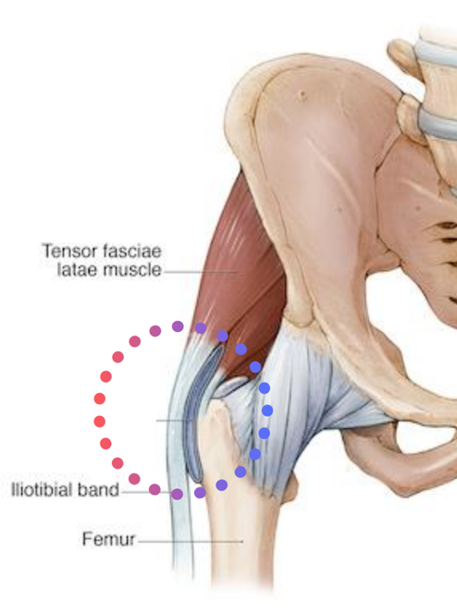
External Snapping Hip
Sports: sports with repetitive hip flexion (gymnastics, dancing)
Mechanism: tight or inflamed IT band snaps across greater trochanter
Presentation: adolescence, pain or audible snapping on lateral aspect of hip with flexion and external rotation, unilateral or bilateral
Exam: pain and snapping reproducible with active flexion and external rotation (but not passive), TTP over greater trochanter and proximal IT band

Slide 62
External Snapping Hip
Diagnosis: clinical, XR may help rule out other pathology if atypical presentation
Plan: activity modifications, NSAIDs, PT (hip muscle strengthening and flexibility, soft tissue massage to tight IT band)
When to refer: persistent symptoms despite several months of PT
Prognosis: pain usually resolves with PT (may take 6+ months), snapping often persists, full RTP expected, often resolves with skeletal maturity
Prevention: maintain hip muscle strength and flexibility, avoid repetitive hip flexion activities

Slide 63
Case 12
17 year-old female p/w atraumatic left shin pain x 6 weeks.
She runs for her high school and club cross-country teams, and recently increased mileage.
Pain is on medial aspect of the middle of the shin, worse with activity, improved with rest, and has been progressing over the course of the past month.
On exam, she has focal TTP over the mid-shin, and single leg hop on the affected leg multiple times elicits pain in the same location.

Slide 64
Case 12
What is the most likely diagnosis?
Medial tibial stress syndrome
Exertional compartment syndrome
Bone tumor
Tibial stress fracture
Enchondroma

Slide 65
Case 12
What is the most likely diagnosis?
Medial tibial stress syndrome
Exertional compartment syndrome
Bone tumor
Tibial stress fracture
Enchondroma

Slide 66
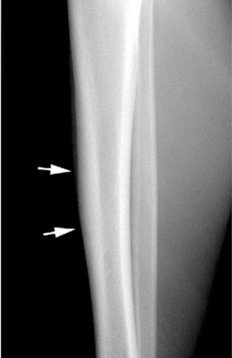
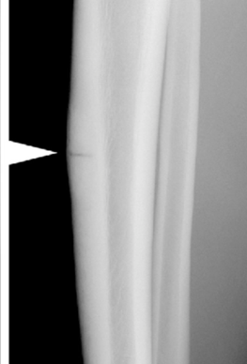
Tibial Stress Fracture
Sports: endurance and high-impact sports (long-distance running, dancing, soccer, track/field)
Mechanism: repetitive load/stress of bone that exceeds ability to form new bone relative to bone resorption → weaker microtrabecular network ➔ fails under persistent load
Presentation: usually adolescence, very focal, localized, progressive shin pain, worse with activity, relieved with rest
Exam: localized TTP, positive single leg hop
Diagnosis: XR may be positive (sclerosis, cortical thickening, periosteal reaction) if present for 4-6 weeks, MRI recommended when XR negative and there is high suspicion

Slide 67
Tibial Stress Fracture
Plan: pain-free weight bearing (boot +/- crutches), activity restrictions, gradual return to activities (after 6-8 weeks), PT (address strength and flexibility imbalances)
When to refer: involvement of anterior tibial cortex (high risk of progression to acute transverse fracture)
Prognosis: if treated complete recovery, if untreated progressive pain (eventually at rest)
Prevention: avoid rapid increases in training (FIT), use proper running shoes and replace when needed, avoid hard or irregular terrain if possible, do not run through persistent pain, evaluate promptly, address risk factors (relative energy deficiency in sport)

Slide 68
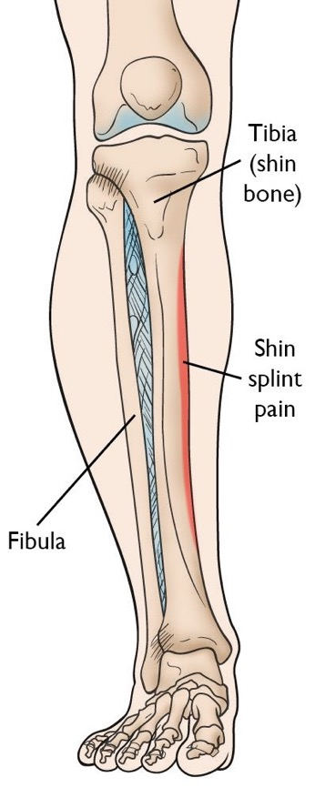
Medial Tibial Stress Syndrome
Shin Splints
Stress fracture must be differentiated from MTSS
Presentation: diffuse medial shin pain in runners, worse with activity, relieved with rest
Exam: diffuse TTP over medial tibia (≠ very focal in tibial stress fracture), no discrete localized lesion
Diagnosis: clinical, may need XR/MRI to rule out stress fracture
Plan: can continue running but reduce total mileage, ice/NSAIDs
Prognosis: spontaneous resolution over time
Prevention: flexibility (hip flexor, calf muscles, quadriceps, hamstring) and strengthening (core, hip external rotators/abductors, calf muscles), cross-training

Slide 69
Case 13
15 year-old female p/w atraumatic left foot pain x 6 weeks.
She dances for the SF Youth Ballet Academy 5-6 times a week for 1-2 hours.
Pain is on dorsal aspect of the left foot, worse with dancing, improved with rest, and has been progressing over the course of the past few weeks.
On exam, she has focal TTP over the middle of the dorsal forefoot. Single leg hop on the left leg multiple times elicits pain in the same location. She has pain when you firmly squeeze the medial and lateral sides of her forefoot together.

Slide 70
Case 13
What is the most likely diagnosis?
Interdigital neuroma
Plantar fasciitis
Metatarsalgia
Metatarsal stress fracture
Freiberg disease

Slide 71
Case 13
What is the most likely diagnosis?
Interdigital neuroma
Plantar fasciitis
Metatarsalgia
Metatarsal stress fracture
Freiberg disease

Slide 72
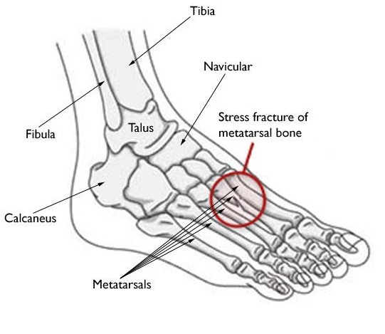
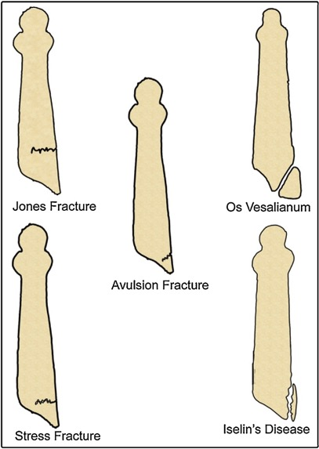
Metatarsal Stress Fracture
Sports: endurance and high-impact sports (running, dancing)
Mechanism: same as tibial stress fractures
Presentation: usually adolescence, very focal, localized, progressive dorsal foot pain, worse with activity, relieved with rest
2nd and 3rd metatarsals most common
5th metatarsal rare but risk of nonunion
Exam: localized TTP, +/- mild soft tissue swelling, positive single leg hop, +/- pain with mediolateral compression of metatarsals or axial loading

Slide 73
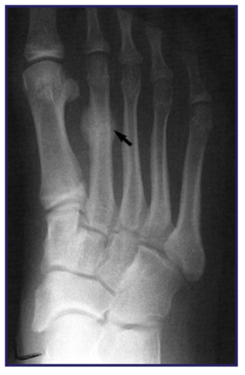
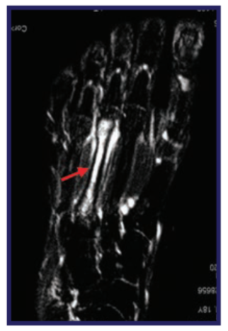
Metatarsal Stress Fracture
Diagnosis: XR (top) may be positive (sclerosis, cortical thickening, periosteal reaction) if present for 4-6 weeks, MRI (bottom) recommended when XR negative and there is high suspicion
Plan: pain-free weight bearing (boot +/- crutches), activity restrictions, gradual return to activities (after 4-6 weeks)
When to refer: fracture of proximal 5th metatarsal at diaphyseal-metaphyseal junction (Jones fracture): risk of nonunion, may need surgical fixation
Prognosis: if treated complete recovery, if untreated progressive pain (eventually at rest)
Prevention: same as tibial stress fractures

Slide 74
Case 14
15 year-old male p/w atraumatic lower back pain x 4 weeks.
He is a lineman for his high school football team and plays 4-5 times a week.
Pain is in the lumbar region, especially on the right side, worse when he plays football and with any back extension, and with some occasional radiation to the buttocks.
On exam, his back extension is limited by pain, and he has very tight hamstrings bilaterally. He has a positive Stork test (single-leg lumbar hyperextension) on the right side.

Slide 75
Case 14
What is the most likely diagnosis?
Lumbar muscle strain
Herniated intervertebral disc
Spondylolysis
Mechanical low back pain
Bone tumor

Slide 76
Case 14
What is the most likely diagnosis?
Lumbar muscle strain
Herniated intervertebral disc
Spondylolysis
Mechanical low back pain
Bone tumor

Slide 77
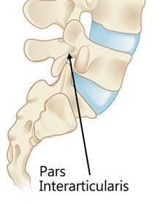
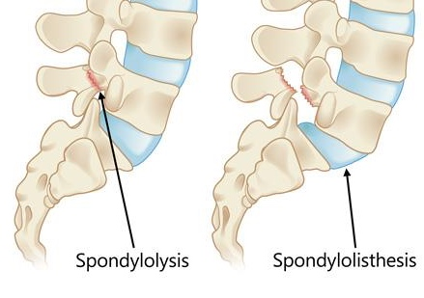
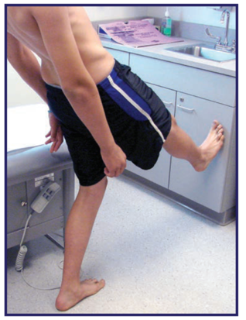
Spondylolysis
Sports: sports that require hyperextension and rotational loading of spine (gymnastics, diving, linemen, pitching, volleyball)
Mechanism: repetitive hyperextension of lumbar spine results in stress reaction or fracture of pars interarticularis (spondylolysis) → may lead to forward translation (slip) of one vertebra over the one beneath it (spondylolisthesis)
Presentation: < 16 years old, activity-related lumbar pain, worse with extension, improved with flexion, +/- radiation to buttock or posterior thigh, most commonly L5
Exam: paraspinal tenderness, limited lumbar mobility, pain with extension leading to lumbar lordosis, tight hamstrings, positive Stork test (single-leg lumbar hyperextension)

Slide 78
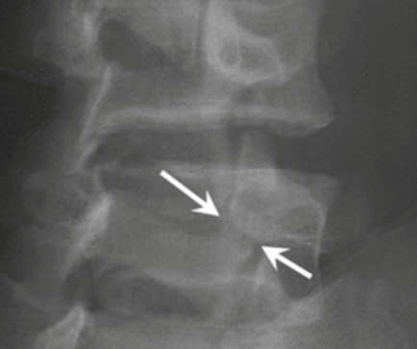
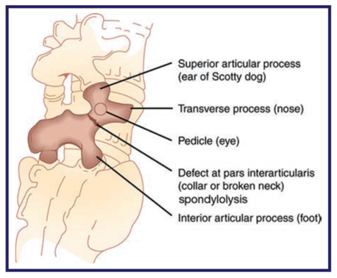
Spondylolysis
Diagnosis: requires imaging, AP and lateral XR sufficient (“Scotty dog sign”), SPECT bone scan if XR negative to detect stress reaction
Plan: avoid impact and hyperextension activities (rest), bracing (controversial, may allow earlier RTP), PT (hamstring flexibility, core and back strengthening, postural techniques)
When to refer: persistent low back pain, pain with hyperextension on physical exertion, sports-related back pain, all spondylolysis/listhesis should be referred, high-grade slips (> 50%) often need surgical treatment
Prognosis: full RTP expected with proper treatment, risk of spondylolisthesis if untreated
Prevention: core strength, hamstring flexibility

Slide 79
Case 15
17 year-old male p/w lower back pain x 2 weeks.
He plays rugby for his high school team 4 times a week and lifts weights on his own 2 times a week. He cannot recall a particular incident but states he plays “’pretty rough”.
He has “shooting” pain in the lower back which radiates down his left leg and is worse with bending over.
On exam, he has pain with forward flexion and a positive straight leg raise on the left. His ankle jerk reflex is slightly diminished on the left.

Slide 80
Case 15
What is the most likely diagnosis?
Lumbar muscle strain
Herniated intervertebral disc
Spondylolysis
Mechanical low back pain
Bone tumor

Slide 81
Case 15
What is the most likely diagnosis?
Lumbar muscle strain
Herniated intervertebral disc
Spondylolysis
Mechanical low back pain
Bone tumor

Slide 82
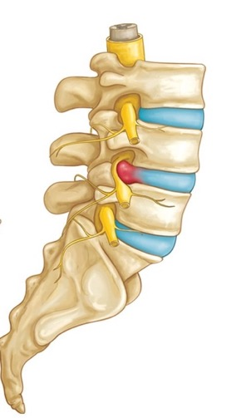
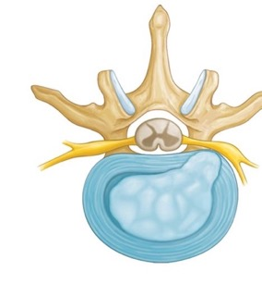
Herniated Intervertebral Disc
Slipped Disc
Sports: weightlifting, rugby, football, any collision sports
Mechanism: increased axial forces exerted on the spine during extreme flexion and extension
Portion of disc extrudes posteriorly and compresses adjacent spinal cord or exiting spinal nerves
Presentation: usually adolescence, sudden onset “burning” or “shooting” lower back pain, +/- radicular leg pain, pain worse with flexion, most common in L4-L5 and L5-S1

Slide 83
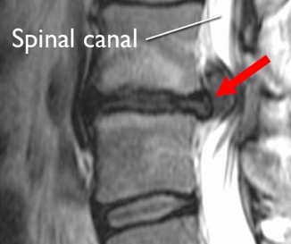
Herniated Intervertebral Disc
Slipped Disc
Exam: pain with forward flexion, positive straight leg raise
Diagnosis: MRI can confirm diagnosis, wait until 4-6 weeks of conservative treatment before imaging (many asymptomatic individuals have disc bulge or protrusion)
Plan: activity modification (avoid prolonged inactivity), NSAIDs PRN, PT once pain has improved, epidural corticosteroid injection for persistent symptoms
When to refer: persistent symptoms despite 4-6 weeks of conservative treatment
Prognosis: high rate of resolution with conservative care
Prevention: proper lifting technique, regular activity

Slide 84
Mechanical Low Back Pain
Also called Hyperlordotic, Muscular, or Idiopathic Low Back Pain
Most common cause of back pain in children is actually mechanical LBP!
Mechanism: related to poor mechanics (weak core and hips, lumbar lordosis), rapid growth and inflexibility
Presentation: any age, chronic and intermittent low back pain, no identifiable pain generator
Exam: increased lumbar lordosis, normal exam, +/- tight hamstrings and hip flexors, weak core and hips
Diagnosis: clinical, no imaging, dx of exclusion
Plan: activity modification, PT (core and hip strengthening, stretching), NSAIDs PRN
Prevention: encourage physical activity, core and hip strength, hamstring and hip flexor flexibility

Slide 85
Back Pain Red Flag Symptoms
Fever, chills, malaise
Anorexia, weight loss, decreased appetite
Unrelenting pain
Night pain
Associated radicular signs or symptoms
Bowel or bladder dysfunction, saddle paresthesia
Focal neurologic deficits
Indications for imaging: ≤ 4 years, ‘Red Flag’ symptoms, duration of symptoms > 6 weeks
If obtaining XR, remember to order lumbar XR in standing position

Slide 86
Case 16
A 10 year-old male presents to clinic for a WCC.
On chart review, you notice he was seen in sports medicine clinic a year ago for heel pain, and was diagnosed with calcaneal apophysitis, which has now improved.
Today, he is complaining of progressive medial elbow pain for the past month, which is worse with throwing.
You learn he is a pitcher on a traveling baseball team. He practices 4-5 times a week, and plays two games each weekend, for a total of about 15-16 hours/week, year-round.
His parents are really excited because he was selected for the state’s All-Star Little League tournament team and they hope he can get an athletic scholarship to play in college.

Slide 87
Case 16
What type of anticipatory guidance do you provide? Select all that apply.
Focusing exclusively on baseball right now will increase his chances to play in college
Participating in multiple sports at least until puberty will reduce his risk of injuries, anxiety, and burnout
Participating in < 15 hours per week of organized sports is recommended at his age
Specializing in baseball later in adolescence will increase his chances to play at an elite level
Taking at least 3 months off throughout the year will reduce his risk of injuries, anxiety, and burnout

Slide 88
Case 16
What type of anticipatory guidance do you provide? Select all that apply.
Focusing exclusively on baseball right now will increase his chances to play in college
Participating in multiple sports at least until puberty will reduce his risk of injuries, anxiety, and burnout
Participating in < 15 hours per week of organized sports is recommended at his age
Specializing in baseball later in adolescence will increase his chances to play at an elite level
Taking at least 3 months off throughout the year will reduce his risk of injuries, anxiety, and burnout

Slide 89
Early Sport Specialization
Definitions
Long-term high-level training in a single sport
Year-round participation (> 8 months/year), multiple teams
No consensus about specific age for "early" sports specialization: <12 years (AOSSM) vs. before adolescence (AAP/AMSSM)
Outcomes
Increased risk of overuse injuries
Increased risk of physical, emotional, and social problems
Increased risk of anxiety, depression, and attrition / early retirement from sports

Slide 90
Guidance for the Pediatrician
Adapted from the AAP Clinical Report on Sports Specialization (2016)
The primary focus of sports for young athletes should be to have fun and learn lifelong physical activity skills. Encourage free, unstructured play.
No clear evidence yet, but some have proposed: participation in hours of organized sports per week < age in years
Participating in multiple sports, at least until puberty, decreases the chances of injuries, stress, and burnout in young athletes.
For most sports, specializing in a sport later (ie, late adolescence, ~15-16 years) may lead to a higher chance of the young athlete accomplishing his or her athletic goals.
Early diversification and later specialization provides for a greater chance of lifetime sports involvement, lifetime physical fitness, and possibly elite participation.

Slide 91
Guidance for the Pediatrician
Adapted from the AAP Clinical Report on Sports Specialization (2016)
Having at least a total of 3 months off throughout the year, in increments of 1 month, from their particular sport of interest will allow for athletes’ physical and psychological recovery. They can still remain active in other activities to meet physical activity guidelines during the time off.
Young athletes having at least 1 to 2 days off per week from their particular sport of interest can decrease the chance for injuries.
Closely monitoring young athletes who pursue intensive training for physical and psychological growth and maturation as well as nutritional status is an important parameter for health and well-being.
Address misconceptions: No evidence that early specialization increases athletic success.

Slide 92
Case 17
A 16 year-old female presents to clinic for a WCC.
On chart review, you notice that she was diagnosed with a metatarsal stress fracture 3 months ago. Today she states she is running again 5-6 times a week without pain.
On HEADS assessment, you learn she gets straight As, runs cross-country competitively and is hoping to qualify for state youth championships in a few months, and is very stressed about her upcoming midterms, leading to frequent insomnia.
On ROS, she mentions cold intolerance and dizziness when she stands up too fast. She also states that she has not had her menses in 6 months. Menarche was at age 13 and menses were previously regular.

Slide 93
Case 17
What is the most appropriate next step? Select all that apply
Inquire further about her nutrition and dietary behaviors.
Provide reassurance that most endurance athletes lose their period.
Prescribe an OCP so she can get her period back.
Screen for depression, anxiety, and suicidal ideation using a validated screening tool.
Check a POCT urine pregnancy test and order screening labs for secondary amenorrhea.
Clear her for full sports participation today.

Slide 94
Case 17
What is the most appropriate next step? Select all that apply
Inquire further about her nutrition and dietary behaviors.
Provide reassurance that most endurance athletes lose their period.
Prescribe an OCP so she can get her period back.
Screen for depression, anxiety, and suicidal ideation using a validated screening tool.
Check a POCT urine pregnancy test and order screening labs for secondary amenorrhea.
Clear her for full sports participation today.

Slide 95
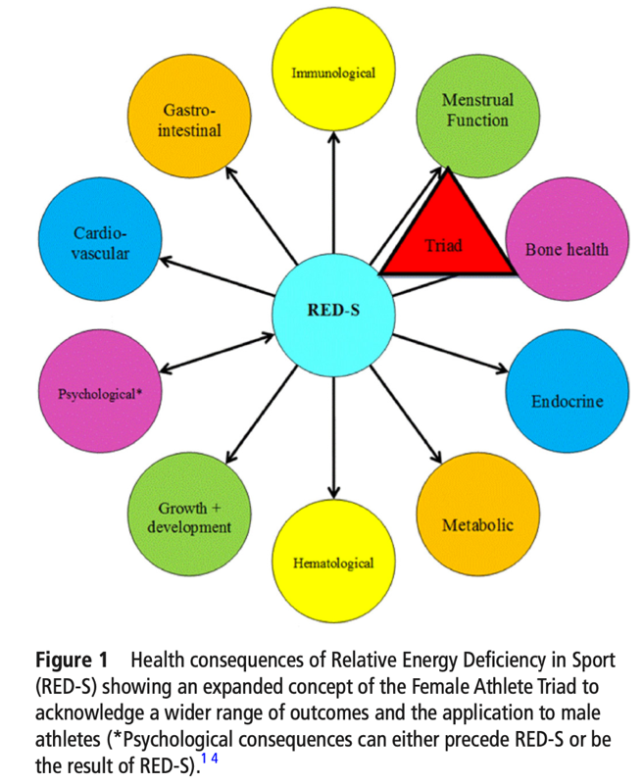
Relative Energy Deficiency in Sport (RED-S)
Expanded Concept Beyond the Female Athlete Triad
RED-S describes impact of energy deficiency on various physiologic functions (see diagram) and performance in athletes
Underlying etiology is low energy availability (LEA)
Mismatch between energy intake (nutrition) and energy expended (training, recovery)
Leaves inadequate energy to support optimal health and physiologic functions as well as optimal performance
LEA
Mountjoy et al. BJSM, 2018.

Slide 96
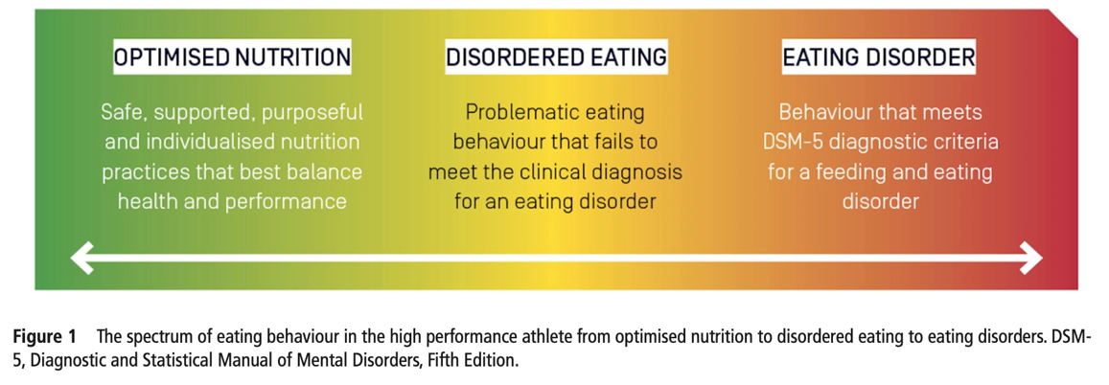
Relative Energy Deficiency in Sport (RED-S)
Expanded Concept Beyond the Female Athlete Triad
Classic triad: disordered eating, osteopenia, amenorrhea
Expanded RED-S concept incorporates application to male athletes and wider range of health consequences beyond triad
Disordered eating includes spectrum of unhealthy nutritional behaviors
Pediatricians must recognize and intervene early to prevent escalation to more serious eating disorders
Wells et al. BJSM, 2020.

Slide 97
References & Image Sources

Slide 98
References
American Academy of Pediatrics, Preparticipation Physical Evaluation Monograph, 5th Edition, 2019.
Brenner JS, AAP Council on Sports Medicine and Fitness. Sports Specialization and Intensive Training in Young Athletes. Pediatrics. 2016;138(3):e20162148.
Carek PJ, et al. The preparticipation physical examination history: who has the correct answers? Clin J Sport Med. 1999;9(3):124-8.
Chun J, et al. The relative contributions of the history and physical examination in the preparticipation evaluation of collegiate student-athletes. Clin J Sport Med. 2006;16(5):437-8.
Coleman N. Sports Injuries. Pediatrics in Review. 2019;40(6):278-90.
Donnell-Fink LA, et al. Effectiveness of knee injury and anterior cruciate ligament tear prevention programs: a meta-analysis. PLoS One. 2015;10(12):e0144063.
Drezner JA, et al. AMSSM Position Statement on Cardiovascular Preparticipation Screening in Athletes: Current Evidence, Knowledge Gaps, Recommendations, and Future Directions. Clin J Sport Med. 2016;26(5):347-61.
Drezner JA, et al. International criteria for electrocardiographic interpretation in athletes: Consensus statement. Br J Sports Med. 2017;51(9):704-31.
Dubon ME, et al. Care of the Transgender Athlete. Curr Sports Med Rep. 2018;17(12):410-8.
Ellington MD, et al. Pediatric Elbow and Wrist Pathology Related to Sports Participation. Orthop Clin North Am. 2016;47(4):743-8.
Emery CA, et al. Neuromuscular training injury prevention strategies in youth sport: a systematic review and meta-analysis. Br J Sports Med. 2015;49:865-70.
Gomez JE, et al. Critical evaluation of the 2-minute orthopedic screening examination. Am J Dis Child. 1993;147(10):1109-13.
Haider, et al. Exercise for Sport-Related Concussion and Persistent Postconcussive Symptoms. Sports Health. 2021;13(2):154-60.
Halstead ME, et al. Sport-Related Concussion in Children and Adolescents. Pediatrics. 2018;142(6):e20183074.
Hewett TE, et al. Biomechanical measures of neuromuscular control and valgus loading of the knee predict anterior cruciate ligament injury risk in female athletes: a prospective study. Am J Sports Med. 2005;33(4):492-501.
Hewett TE, et al. Preparticipation physical examination using a box drop vertical jump test in young athletes: the effects of puberty and sex. Clin J Sport Med. 2006;16(4):298-304.

Slide 99
References
Koester MC, et al. Preparticipation screening of high school athletes: are recommendations enough? Phys Sportsmed. 2003;31(8):35-8.
LaBella et al, Anterior Cruciate Ligament Injuries: Diagnosis, Treatment, and Prevention. Pediatrics. 2014;133(5)e1437-50.
Lauersen JB, et al. Strength training as superior, dose-dependent and safe prevention of acute and overuse sports injuries: a systematic review, qualitative analysis and meta-analysis. Br J Sports Med. 2018;52:1557-63.
MacDonald J, et al. Musculoskeletal Low Back Pain in School-aged Children: A Review. JAMA Pediatr. 2017;171(3):280-7.
Maron BJ, et al. Assessment of the 12-lead electrocardiogram as a screening test for detection of cardiovascular disease in healthy general populations of young people (12-25 years of age): a scientific statement from the American Heart Association and the American College of Cardiology. J Am Coll Cardiol. 2014;64(14):1479-1514.
Maron BJ, et al. Eligibility and Disqualification Recommendations for Competitive Athletes With Cardiovascular Abnormalities: Preamble, Principles, and General Considerations: A Scientific Statement From the American Heart Association and American College of Cardiology. Circulation. 2015;132(22):e256-61.
Marra J, et al. Clinical Considerations in Caring for Transgender Athletes. Am Fam Physician. 2021;103(9):518-20.
Miller SM, et al. The Sports Preparticipation Evaluation. Pediatrics in Review. 2019;40(3):108-28.
Mountjoy M, et al. The IOC consensus statement: beyond the Female Athlete Triad – relative energy deficiency in sport (RED-S). Br J Sports Med. 2014;48:491-7.
Mountjoy M, et al. IOC consensus statement on relative energy deficiency in sport (RED-S): 2018 update. Br J Sports Med. 2018;52(11):687-97.
Nigrovic LE, et al. Children With Minor Blunt Head Trauma Presenting to the Emergency Department. Pediatrics. 2019;144(6):e20191495.
Sarwark, JS, & LaBella, CR (2014). Pediatric Orthopaedics and Sports Injuries: A Quick Reference Guide, 2nd Edition. American Academy of Pediatrics.
Smith J, et al. The preparticipation physical examination: Mayo Clinic experience with 2,739 examinations. Mayo Clin Proc. 1998;73(5):419-29.
Thorborg K, et al. Effect of specific exercise-based football injury prevention programmes on the overall injury rate in football: a systematic review and meta-analysis of the FIFA 11 and 11+ programmes. Br J Sports Med. 2017;51:562-71.
Rice SG, AAP Council on Sports Medicine and Fitness. Medical conditions affecting sports participation. Pediatrics. 2008;121(4):841-8.

Slide 100
Image Sources
In order of appearance
Bone structure diagram: Cole D, Medellin J, Wennell RC, Lavallee ME (2020) Fracture Types and Definitions. In: Khodaee M, Waterbrook A, Gammons M (eds) Sports-related Fractures, Dislocations and Trauma. Springer, Cham.
Pitcher’s elbow diagram: The Orthopedic and Sports Medicine Institute (OSMI), Pitcher’s Elbow: https://www.osmifw.com/orthopedic-diseases-disorders/elbow-injuries-disorders/pitchers-elbow-medial-epicondyle-apophysitis/_pitchers-elbow-medial-epicondyle-apophysitis-3/
Little league elbow radiograph: Delgado J, et al. Imaging the Injured Pediatric Athlete: Upper Extremity. Radiographics. 2016;36(6):1672-87.
Osgood vs SLJ diagram: Greg Robinson Podiatrist, Sinding-Larsen-Johansson syndrome: http://www.fixmyfeet.co.za/sinding-larsen-johansson-syndrome-pain-at-the-bottom-of-the-kneecap.html
SLJ radiograph: OrthoBullets, Osgood Schlatter's Disease: https://www.orthobullets.com/knee-and-sports/3029/osgood-schlatters-disease-tibial-tubercle-apophysitis
Sever’s anatomy diagram: American Academy of Orthopaedic Surgeons, OrthoInfo, Sever’s disease: https://orthoinfo.aaos.org/en/diseases--conditions/severs-disease/
Squeeze test: AthleteBiz, Stress Fractures and their Treatment: https://www.athletebiz.us/blog/stress-fractures-and-their-treatment-dr-brian-fullem/
Calf stretching diagram: Sarwark, JS, & LaBella, CR (2014). Pediatric Orthopaedics and Sports Injuries: A Quick Reference Guide, 2nd Edition. AAP.
Gel heel cups: ProTherapySupplies, Medi-Dyne - Tulis Heavy Duty Gel Heel Cups: https://www.protherapysupplies.com/Shop-by-Brand/Medi-Dyne/Medi-Dyne-Tulis-Heavy-Duty-Gel-Heel-Cups
Iselin anatomy diagram: Children’s Orthopaedic and Scoliosis Surgery Associates, Understanding your Iselin Disease: https://www.chortho.com/system/resources/W1siZiIsIjIwMTgvMTAvMTIvMTkvMjAvMjMvYTA4YzY1MGUtZGU 4ZC00ZWNhLTk3MzUtY2I2YWU4NWQwYTNkL0lzZWxpbiBEaXNlYXNlLnBkZiJdXQ/Iselin%20Disease.pdf

Slide 101
Image Sources
In order of appearance
Iselin and 5th metatarsal fracture types diagram: Kishan TV, et al. Iselin's disease: Traction apophysitis of the fifth metatarsal base, a rare cause of lateral foot pain. Medical Journal, Armed Forces India. 2016;72(3):299-301.
Iselin radiograph: OrthoBullets, Iselin’s Disease: https://www.orthobullets.com/pediatrics/4073/iselins-disease
Proximal humerus epiphysis diagram: Orthopedics for Kids, Little League Shoulder: https://pdf4pro.com/fullscreen/little-league-should-4b41f8-orthopedics-for-kids-497a9.html
Proximal humerus epiphysis radiograph (top): Sarwark, JS, & LaBella, CR (2014). Pediatric Orthopaedics and Sports Injuries: A Quick Reference Guide, 2nd Edition. AAP.
Proximal humerus epiphysis radiograph (bottom): 2021 UpToDate, Young C. Throwing injuries of the upper extremity: Clinical presentation and diagnostic approach.
Gymnast wrist diagram (top): Ellington MD, et al. Pediatric Elbow and Wrist Pathology Related to Sports Participation. Orthop Clin North Am. 2016;47(4):743-8.
Gymnast wrist diagram (bottom): Little JT, et al. Pediatric distal forearm and wrist injury: an imaging review. Radiographics. 2014;34(2):472-90.
Gymnast wrist radiographs: OrthoBullets, Gymnast's Wrist: https://www.orthobullets.com/hand/6052/gymnasts-wrist-distal-radial-physeal-stress-syndrome
Patella stabilizers diagram: Juhn MS. Patellofemoral pain syndrome: a review and guidelines for treatment. Am Fam Physician. 1999;60(7):2012-22.
Patellar anatomy diagram: American Academy of Orthopaedic Surgeons, OrthoInfo, Patellofemoral Pain Syndrome: https://orthoinfo.aaos.org/en/diseases--conditions/patellofemoral-pain-syndrome/
Patellar grind test: Physiopedia, Patellar Grind Test: https://www.physio-pedia.com/Patellar_Grind_Test
Valgus collapse on single-leg squat: American Academy of Pediatrics, Preparticipation Physical Evaluation Monograph, 5th Edition, 2019.

Slide 102
Image Sources
In order of appearance
IT Band anatomy: 2021 UpToDate, Jackson J. Iliotibial band syndrome.
IT Band compression test and Thomson test: Sports Injury Bulletin, Illiotibial band syndrome: diagnosis and treatment: https://www.sportsinjurybulletin.com/illiotibial-band-syndrome-diagnosis-and-treatment/
IT Band Ober test: Sarwark, JS, & LaBella, CR (2014). Pediatric Orthopaedics and Sports Injuries: A Quick Reference Guide, 2nd Edition. AAP.
Shoulder anatomy diagram: Yeovil Hospital Healthcare, Sub-Acromial Decompression: https://yeovilhospital.co.uk/sub-acromial-decompression/
Impingement syndrome diagram: Keenan CR, & Blotzer J (2012). Chapter 52. Shoulder pain. Henderson MC, & Tierney LM, Jr., & Smetana GW(Eds.), The Patient History: An Evidence-Based Approach to Differential Diagnosis. McGraw Hill.
Shoulder exam, landmarks and Hawkins test: Sarwark, JS, & LaBella, CR (2014). Pediatric Orthopaedics and Sports Injuries: A Quick Reference Guide, 2nd Edition. AAP.
Shoulder exam, Neer test: Woodward TW, et al. The painful shoulder: part I. Clinical evaluation. Am Fam Physician. 2000;61(10):3079-88.
Internal snapping hip anatomy diagram: Sport & Spinal Physiotherapy, Dancers: How to Fix a Clicking Hip - Snapping Hip Syndrome: https://sportandspinalphysio.com.au/dancers-how-to-fix-a-clicking-hip-snapping-hip-syndrome/
Internal snapping hip labral tear: Lexmedicus, Snapping Hip: https://pathologies.lexmedicus.com.au/collection/snapping-hip-coxa-saltans-2
External snapping hip anatomy diagram: Simone Muscat Physio, Injury Spotlight - The Snapping Hip: https://www.simonemuscat.physio/injury-spotlight-the-snapping-hip
Tibial stress fracture radiographs (top and bottom): Swischuk LE, et al. Tibial stress phenomena and fractures: imaging evaluation. Emerg Radiol. 2014;21(2):173-7.
Medial tibial stress syndrome diagram: American Academy of Orthopaedic Surgeons, OrthoInfo, Shin Splints: https://orthoinfo.aaos.org/en/diseases--conditions/shin-splints/

Slide 103
Image Sources
In order of appearance
Metatarsal stress fracture anatomy: American Academy of Orthopaedic Surgeons, OrthoInfo, Stress Fractures of the Foot and Ankle: https://orthoinfo.aaos.org/en/diseases--conditions/stress-fractures-of-the-foot-and-ankle/
Iselin and 5th metatarsal fracture types diagram: Kishan TV, et al. Iselin's disease: Traction apophysitis of the fifth metatarsal base, a rare cause of lateral foot pain. Medical Journal, Armed Forces India. 2016;72(3):299-301.
Metatarsal stress fracture radiograph and MRI: Sarwark, JS, & LaBella, CR (2014). Pediatric Orthopaedics and Sports Injuries: A Quick Reference Guide, 2nd Edition. AAP.
Spondylolysis anatomy diagram: American Academy of Orthopaedic Surgeons, OrthoInfo, Spondylolysis and Spondylolisthesis: https://orthoinfo.aaos.org/en/diseases--conditions/spondylolysis-and-spondylolisthesis/
Stork test: Sarwark, JS, & LaBella, CR (2014). Pediatric Orthopaedics and Sports Injuries: A Quick Reference Guide, 2nd Edition. AAP.
Scotty dog sign radiograph: Radiology Key, Pediatric Considerations in Sports-Specific Injuries: https://radiologykey.com/pediatric-considerations-in-sports-specific-injuries/
Scotty dog sign diagram: Sarwark, JS, & LaBella, CR (2014). Pediatric Orthopaedics and Sports Injuries: A Quick Reference Guide, 2nd Edition. AAP.
Herniated disc diagram (top and bottom) and MRI: American Academy of Orthopaedic Surgeons, OrthoInfo, Herniated Disk in the Lower Back: https://orthoinfo.aaos.org/en/diseases--conditions/herniated-disk-in-the-lower-back/
Lumbar lordosis diagram: Strauss Scoliosis Correction, Lordosis: Causes, Symptoms, and Treatments: https://www.hudsonvalleyscoliosis.com/what-is-scoliosis/lordosis/
RED-S figure: Mountjoy M, et al. The IOC consensus statement: beyond the Female Athlete Triad – relative energy deficiency in sport (RED-S). Br J Sports Med. 2014;48:491-7.
Spectrum of disordered eating figure: Wells KR, et al. The Australian Institute of Sport (AIS) and National Eating Disorders Collaboration (NEDC) position statement on disordered eating in high performance sport. Br J Sports Med 2020;54:1247-1258

